Slide 1
Welcome
Jennifer Shuler, Nurse Practitioner
RADD Program Coordinator
Division of Aging, Adult, and Behavioral Health Services
Jennifer.shuler@dhs.arkansas.gov
Office: (501) 396-6347
Cell: (501) 416-9401

Slide 2
RADD Training Agenda
Regional Alcohol and Drug Detoxification Training
Agenda:
Detoxification
RADD and RDS process
Evaluation of client
Admission/Denial of client
Universal Precautions
Vital Signs
Vital Signs Practice
Drugs and their Effects; levels of withdrawal
Documentation
Written Exam

Slide 3
RADD Training Objectives
Identify responsibilities of RADD staff
Identify symptoms of alcohol/drug withdrawal and implications of those symptoms
Learn to take vital signs and know the implications of those signs
Prepare participants to score 80% or better on written exam required to obtain certification

Slide 4
RADD Qualified Staff
To monitor clients in DETOX you must be one of the following:
Physician
Advanced Practice Registered Nurse
Registered Nurse
Licensed Practical Nurse
Regional Detoxification Specialist (RDS)

Slide 5
RDS is a qualified individual responsible for….
Screening applicants for admission
Evaluating/documenting presenting symptoms
Compiling an accurate substance abuse history
Taking vital signs and interpreting their meaning
Diffusing hostile situations in a nonviolent manner
Providing CPR/First Aid (as necessary)
Documenting any occurrence relative to the detox process

Slide 6

What is an RDS?
RDS is an acronym that stands for Regional Detoxification Specialist
According to the Alcohol and Drug Abuse Prevention Rules of Practice and Procedure, training will provide competency at a minimum:
Current RADD Program Policy and Procedure
Taking of Vital Signs
Evaluation of presenting symptoms and compiling an accurate substance abuse history
Current certification in cardiopulmonary resuscitation (CPR)
Current certification in a First Aid Course
Current Non-violent Crisis Prevention and Intervention (CPI) training in diffusing hostile situations
Knowledge of alternate social, rehabilitative and emergency referral sources
Notes:
Alcohol and drug abuse prevention rules of practice and procedure, 7.1.2009; page 56-57

Slide 7
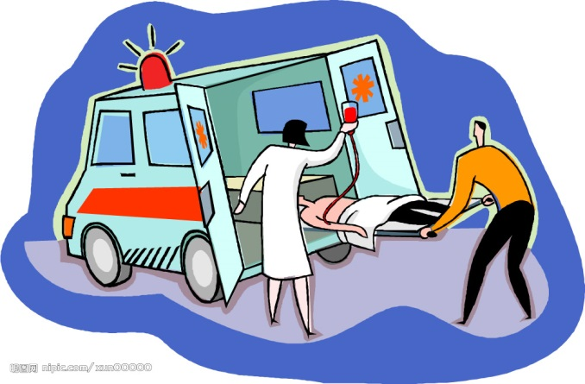
Emergency Procedures
There must be documentation in personnel file that the RDS is knowledgeable of emergency procedures, as identified in the facility policy and procedure manual.
In any emergency, follow your facilities policies and procedures

Slide 8
Chapter 1
Overview, Essential Concepts, and Definitions in Detoxification

Slide 9
Definitions
Evaluation entails testing for the presence of substances of abuse in the bloodstream, measuring their concentration, and screening for co-occurring mental and physical conditions. Evaluation also includes a comprehensive assessment of the patient’s medical and physiological conditions, and social situation to help determine the appropriate level of treatment following detoxification. Essentially, the evaluation serves as the basis for the initial substance abuse treatment plan once the patient has been withdrawn successfully.
Notes:
Dictionary.com

Slide 10
Definitions
Stabilization includes the medical and psychosocial processes of assisting the patient through acute intoxication and withdrawal to the attainment of a medically stable, fully supported, substance-free state. This often is done with the assistance of medications, though in some approaches to detoxification no medication is used. Stabilization includes familiarizing patients with what to expect in the treatment milieu and their role in treatment and recovery.

Slide 11
Entry into Treatment
Fostering the patient’s entry into treatment involves preparing the patient for entry into substance abuse treatment by stressing the importance of following through with the complete substance abuse treatment continuum of care. For patients who have demonstrated a pattern of completing detoxification services and then failing to engage in substance abuse treatment, consideration of a written treatment contract may be advisable. This contract is not legally binding but is voluntary and can be utilized to remind patients of their goals at intake to treatment.

Slide 12
Detoxification
Detoxification is a set of interventions aimed at managing acute intoxication and withdrawal. It denotes a clearing of toxins from the body of the patient who is acutely intoxicated and/or dependent on substances of abuse. Detoxification seeks to minimize the physical harm caused by the abuse of substances.

Slide 13
Goals of Detoxification
Detoxification safely manages the physical symptoms of withdrawal
Only the first stage of addiction treatment
Alone, does little to change long term drug use
Notes:
https://www.drugabuse.gov/publications/teaching-packets/understanding-drug-abuse-addiction/section-iii/7-medical-detoxification

Slide 14
Chapter 2
Settings, Levels of Care, and Patient Placement

Slide 15

Evaluation Process
Observe the condition of the client
What you see, hear, smell, and feel is important!
Listen for clues about how the client actually feels.
Remain alert to the client’s responses to gain insight into their condition.

Slide 16
Environment of Care
If a situation deteriorates (client starts acting out) STOP THE EVALUATION PROCESS
Ask the individual to leave
Assure them they may return when they can be more cooperative
Never put yourself in a harmful situation
Contacting the police should always be an option

Slide 17
Evaluation Process
Document
Vital signs on the evaluation form
Client’s history of substance abuse
Symptoms reported by the client
Signs you see, hear, smell, and feel
Signs reported by the person accompanying client
Use all information available to assure the client is referred to the appropriate level of care.

Slide 18
After the Evaluation
Options include:
Admission to observational detox
Referral for medical detox
Know your facility policy on how to make appropriate referrals!

Slide 19
Admissions
Each client for new admission, re-admission, or transfer admission is interviewed and the interview is documented.
During the intake process, it is important to document that an effort has been made to ensure the client understands policies and procedures, services available, costs, client rights and program rules.

Slide 20
Admissions
Individuals presenting themselves for RADD program services will be evaluated by a Regional Detoxification Specialist. Admission to the RADD program includes ACT 10 (Act 1268 of 1995 Amended) the voluntary and involuntary commitment law for substance abuse.

Slide 21
Admissions
Voluntary
Any person who believes him/herself to be addicted to alcohol or drugs may apply for admission.
Involuntary
For individuals presenting for admission who have been ordered, by the court system, into treatment.
This type court order gives the designated facility permission to “treat and restrain” up to 21 days

Slide 22

Denial of Admission
Under 18 years of age
Belligerent or combative
Overriding medical problems

Slide 23
Examples of Overriding Medical Problems
Broken bones
Bleeding wound (s), including nose bleeds
Excessive bruising, especially on the face or head
Seizure disorder
Diabetes
High blood pressure
Chest pain
Excessive vomiting (blood or blood tinged)
Protruding abdomen (distended)
Jaundice

Slide 24
Symptoms and Signs of Conditions that Require Medical Attention
Change in mental status
Increasing anxiety and panic
Hallucinations
Seizures
Temperature greater than 100.4 degrees Fahrenheit (these clients should be considered potentially infectious)
Significant increases and or decreases in blood pressure and heart rate
Insomnia
Abdominal pain
Upper and lower gastrointestinal bleeding
Changes in responsiveness of pupils
Heightened deep tendon reflexes and ankle clonus, a reflex beating of the foot when pressed rostrally (i.e. toward the mouth of the patient, indicated profound central nervous system irritability and the potential for seizures)

Slide 25
Denial of Admission
The RDS will write a refusal note indicating….
1. Reason(s) refused
2. Alternative(s) suggested
3. Referral(s) made
Care will be taken by the RDS to ensure the applicant is referred to the appropriate level of service.

Slide 26
Admission Priority
Court ordered clients
Arkansas Commitment law
Act 10 (Act 1268 of 1995 as amended)
Client with the greatest clinical need
If all have the same clinical need, then IV drug users and pregnant clients have priority
Clients from your catchment area
Clients from the state of Arkansas
Clients from outside the state of Arkansas

Slide 27
Admissions Process
The Withdrawal Risk Assessment will be initiated upon admission; completed and filed in the client record within 4 hours of admission.
If the client’s physical condition prevents completion of documentation, an explanation of the circumstances should be placed in the client record and the information obtained as soon as possible.

Slide 28
Universal Precautions
Universal Precautions (UP) are measures you can take to prevent the spread of infectious disease-from the common disease such as colds, flu, mumps, chicken pox, tuberculosis, and food poisoning-to more life threatening disease like AIDS and hepatitis.
These precautions protect both you and the client from any potential infection.
Assume that every client is infected. Protect yourself and the client.

Slide 29

Universal Precautions
Wash your hands before and after taking vital signs.
Notes:
Page 36

Slide 30
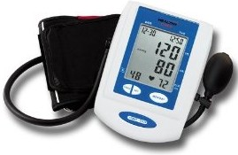
Vital Signs
Understanding the Why, When, What, Where and How of Vital Signs
Notes:
Page 37

Slide 31
What are Vital Signs?
Vital signs are measurements of the body’s most basic functions. They show how well the body is functioning.
They include:
Temperature
Pulse
Respirations
Blood pressure (Systolic/Diastolic)
Medline Plus, NIH
Notes:
Your vital signs show how well your body is functioning. They are usually measured at doctor's offices, often as part of a health checkup, or during an emergency room visit. They include
Blood pressure, which measures the force of your blood pushing against the walls of your arteries. Blood pressure that is too high or too low can cause problems. Your blood pressure has two numbers. The first number is the pressure when your heart beats and is pumping the blood. The second is from when your heart is at rest, between beats. A normal blood pressure reading for adults is lower than 120/80 and higher than 90/60.
Heart rate, or pulse, which measures how fast your heart is beating. A problem with your heart rate may be an arrhythmia. Your normal heart rate depends on factors such as your age, how much you exercise, whether you are sitting or standing, which medicines you take, and your weight.
Respiratory rate, which measures your breathing. Mild breathing changes can be from causes such as a stuffy nose or hard exercise. But slow or fast breathing can also be a sign of a serious breathing problem.
Temperature, which measures how hot your body is. A body temperature that is higher than normal (over 98.6 degrees F) is called a fever.

Slide 32
Vital Signs Documentation
Ensure documentation upon admission, and
At least every 2 hours thereafter, until….
Vital signs are within normal limits for 8 hours, then they can be taken every 6 hours during detoxification, unless abnormal
If vital signs are abnormal, resume every 2 hour checks until normal for 8 hours again

Slide 33

Vital Signs Frequency
Once within normal limits for eight (8) hours, vital signs will be taken no less than every six (6) hours.
There must be documentation in the client’s case record verifying each vital sign taken during the client’s stay in the detoxification unit.

Slide 34
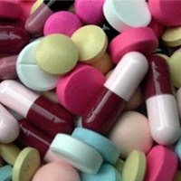
Also take vital signs…
Whenever the client reports any non-specific symptoms of physical distress such as feeling “funny” or “different”
When the client’s physical condition changes
Before and after ingestion of certain medications.

Slide 35
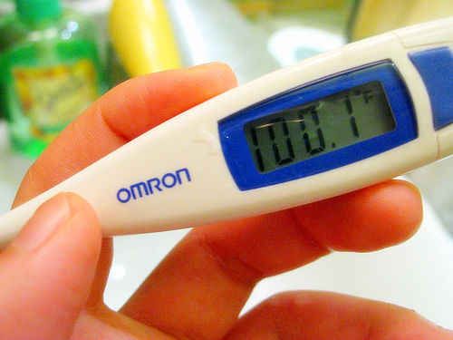
Temperature
Normal body temperature varies depending on age, gender, recent activity, food and fluid consumption, and time of day.
Normal ranges from 97.8 to 99.1 degrees Fahrenheit
Medline Plus; NIH

Slide 36
Factors Affecting Body Temperature
Normal body temperature may change during any given day. It is usually highest in the evening. Other factors that may affect body temperature are:
A woman's menstrual cycle. In the second part of this cycle, her temperature may go up by 1 degree or more.
Physical activity, strong emotion, eating, heavy clothing, medicines, high room temperature, and high humidity can all increase body temperature.
Medline Plus, NIH
Notes:
https://medlineplus.gov/ency/article/003090.htm

Slide 37

Assessing Temperature
Wait 20 to 30 minutes to measure oral temperature after a client:
Ingests hot or cold liquids or food
Smokes
Has been involved in strenuous physical activity

Slide 38
Fever
Body temperature above 99 to 99.5 degrees Fahrenheit indicates infection, elevated body temperature is usually not harmful if it stays below 102 degrees Fahrenheit.
According to Medline Plus; NIH
As body temperature rises-metabolism increases, oxygen demand increases, this causes heart and respiratory rates to increase.
Confusion can result because of reduced oxygen to the brain.
Places client at risk for dehydration.
Notes:
https://medlineplus.gov/ency/article/003090.htm

Slide 39

Common Symptoms of Fever
Headache
Muscle aches
Chills
Nausea
Photophobia (sensitivity of the eyes to light)
Weakness
Fatigue
Loss of appetite (anorexia)
Excessive thirst

Slide 40
Possible Observations in Fever
Sweating (Diaphoresis)
Dry skin and mucous membranes indicated possible dehydration
Confusion
Restlessness
Disorientation

Slide 41
Interventions for Fever
Reduce activities, allow for rest
Discourage smoking-because of increased oxygen consumption; client needs all available oxygen
Offer well-balanced meals to meet increased metabolism needs
Provide extra fluids
Take temperature immediately after chilling episode

Slide 42
Interventions for Fever
Reduce external covering to promote heat loss
Keep clothing and bed linen dry
Control temperature of environment
Limit physical activity
DO NOT INDUCE CHILLS

Slide 43
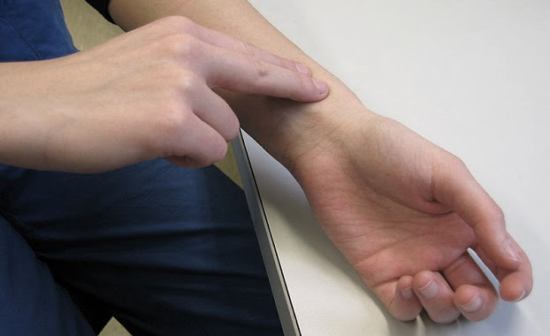
Pulse
The RADIAL artery is typically used to take a pulse. The pulse can be felt on the side of the lower neck, inside the elbow, behind the knee, or at the wrists and ankles.
When taking a pulse: Use your first and second fingertips. Press firmly, but gently on the radial artery, located on the thumb side of the wrist. Count for 1 minute, noting regularity.

Slide 44
Pulse Rate
Pulse rate is a measurement of the heart rate, or the number of times the heart beats per minute.
As the heart pushes blood through the arteries, the arteries expand and contract with the flow of blood.
Taking a pulse not only measures the heart rate, but also can indicated heart rhythm and adequate circulation.

Slide 45

Normal Pulse Rate
For an average sized, healthy adult
60 to 100 beats per minute (bpm)
To assess pulse, count for a full minute, pay attention to if it is regular or irregular

Slide 46
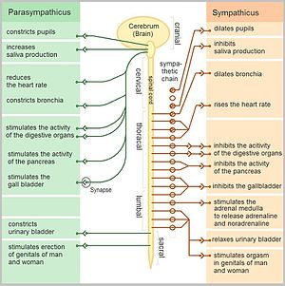
Factors influencing pulse rate
Activity
Heat
Fever
Acute pain
Anxiety
Unrelieved, severe, chronic pain
Medications
Significant blood loss
Changes in posture
Lying down (decreases the pulse rate)
Sitting or standing (increases the pulse rate)

Slide 47
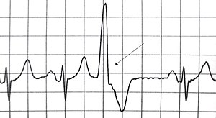
Note if pulse is regular or irregular
Regular-evenly spaced beats, may vary slightly
Regularly irregular-regular pattern overall with “skipped” beats
Irregularly irregular-chaotic, no real pattern, very difficult to measure rate accurately
If irregular, count for a full minute
Ask client if this is a known issue
Record in chart
Notify appropriate staff member

Slide 48
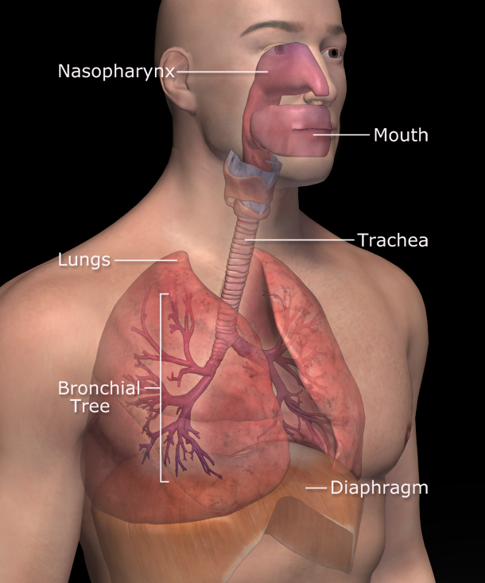
Respirations
Respiration is the number of breaths a person takes per minute.
The normal rate for a healthy adult at rest is 12 to 18 breaths per minute
According to Medline Plus; NIH
Notes:
https://medlineplus.gov/ency/article/002341.htm

Slide 49
Assessing Respirations
Assess by observing the chest wall rise and fall for 15 seconds, then multiply by 4. (6 x 4 is 24)
One (1) breath= A full inspiration and expiration
Do not let client know you are assessing breaths!

Slide 50
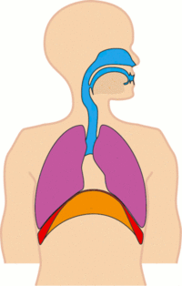
Factors affecting Respirations
Anxiety
Anemia
Activity
Acute Pain
Smoking
Body position
Medications
Narcotic analgesics and sedatives (may decrease rate and rhythm)
Amphetamines and cocaine (may increase rate and rhythm)

Slide 51
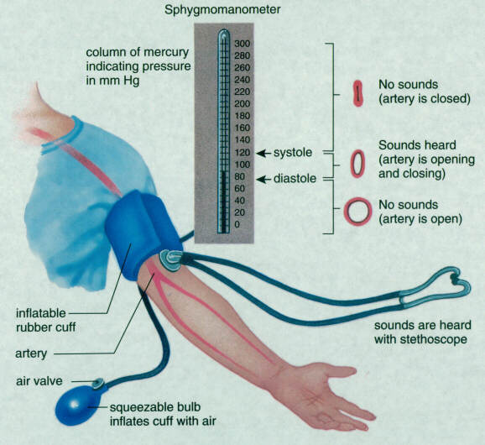
Blood Pressure
Defined as the measurement of the force of the blood pushing against the artery walls.
Standard unit of measurement is millimeters of mercury (mmHg)
Normal blood pressure ranges from 90/60 mmHg to 120/80 mmHg
According to Medline Plus; NIH
Notes:
https://medlineplus.gov/ency/article/002341.htm

Slide 52
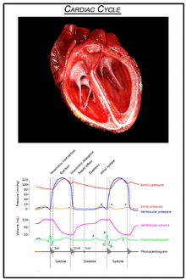
Blood Pressure
During normal cardiac cycle
Pressure reaches a peak
Pressure inside the brachial artery is at its maximum as the heart contracts and pumps blood through the body
This is a systolic pressure (higher number), or the first sound you will hear with a manual blood pressure check.

Slide 53
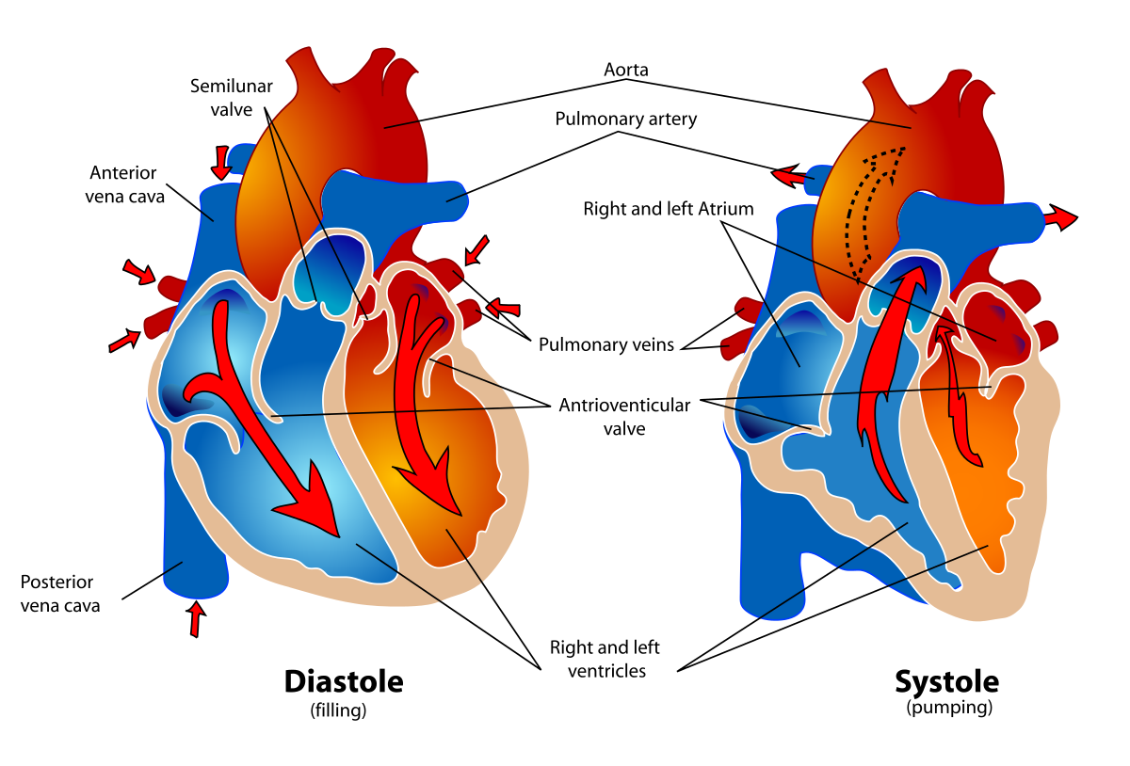
Blood Pressure
During normal cardiac cycle
Pressure drops to a low
Pressure inside the brachial artery is at a minimum as the heart relaxes and is filling with blood.
This is the diastolic pressure (lower number), or the last sound you hear during a manual blood pressure check

Slide 54
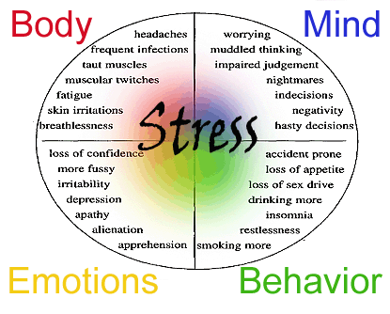
Factors Influencing Blood Pressure
Age
Stress
Gender
Race
Medications
Time of Day variation
Hypertension

Slide 55
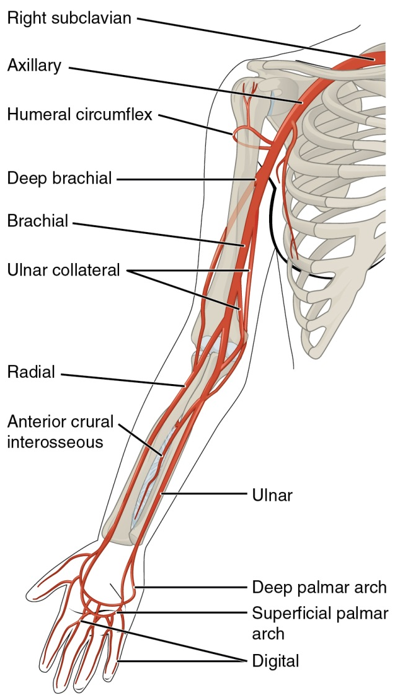
Measuring Blood Pressure
May use electronic cuff
Manual measurement: you will need a quiet room, 2 chairs, a stethoscope and a blood pressure cuff (sphygmomanometer)
Wait 5 minutes prior to checking blood pressure, ensure the client is comfortable.
Feel for brachial artery (inside of elbow)
Apply cuff to upper arm (2 cm above the fold) and inflate until brachial artery pulse cannot be felt.
Place stethoscope over brachial artery
Slowly release valve and listen for sounds while watching the manometer, allow mercury to fall at a rate of 2-3 mmHg per second
Note the first and last sounds you hear, these are the systolic and diastolic values.
Deflate cuff completely and remove

Slide 56
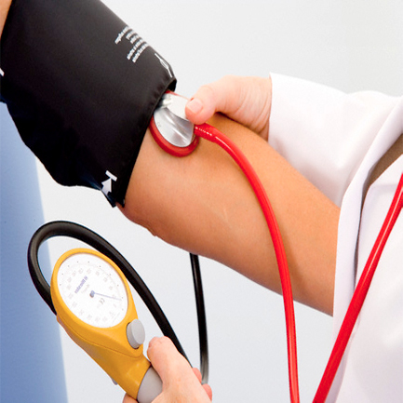
Hypertension
One high blood pressure recording does not qualify as a diagnosis of hypertension. There must be three readings at different times.
A diagnosis of hypertension can only be made by a provider. (MD, DO, APRN, PA)

Slide 57
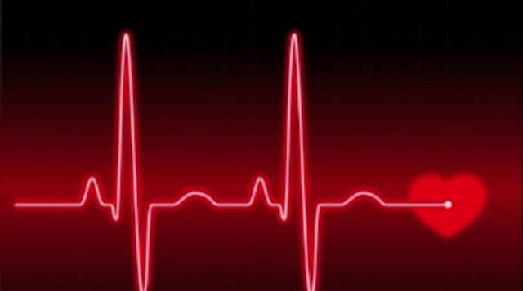
Vital Signs Practice

Slide 58
Chapter 3
An Overview of Psychosocial and Biomedical Issues During Detoxification

Slide 59
Overarching Principles for Care During Detoxification Services
Substance use disorders are treatable, and there is hope for recovery.
Substance use disorders are brain disorders and not evidence of moral weaknesses.
Patients are always treated with respect and dignity
Patients are treated in a nonjudgmental and supportive manner.

Slide 60
Psychosocial Issues
Detoxification is challenging, but Regional Detoxification Specialists (RDS) are equipped to provide safe and humane withdrawal from substances, and they are uniquely positioned to foster the patient’s entry into long term treatment and recovery. Clients presenting to detox are often in a crisis, and a therapeutic approach to their admission is often key to retaining the client in treatment. Research indicates that addressing key psychosocial issues during detoxification
“significantly increases the likelihood that the patient will experience a safe detoxification and go on to participate in substance abuse treatment. Staff members ability to respond to patient’s needs in a compassionate manner can make the difference between a return to substance abuse and the beginning of a new (and more positive) way of life.” (TIP 45 page 23)

Slide 61
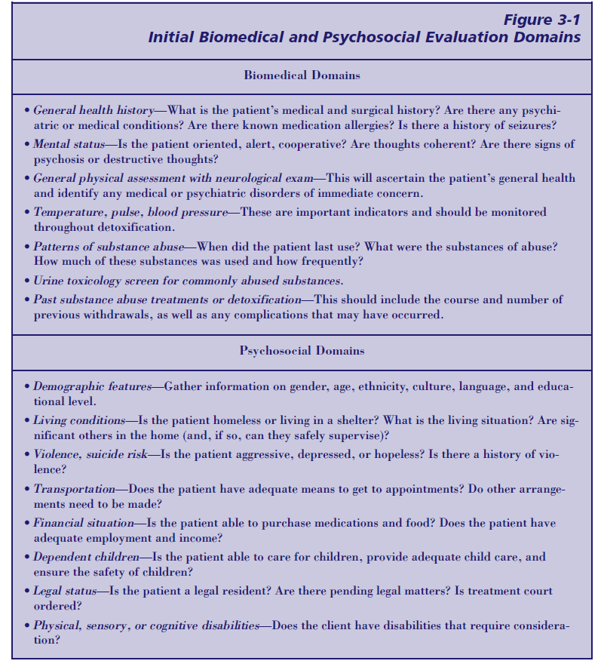
Biomedical and Psychosocial Evaluation Domains

Slide 62
Chapter 4
Physical Detoxification Services for Withdrawal from Specific Substances

Slide 63

Drugs and Their Effects
The Three Ants were born on a late spring day in 1987. Their purpose was to help lay-people understand the basic pharmacology of psychoactive drugs. The names of the three ants describes the actions produced by each of three general groups of psychoactive drugs. The Three Ants thus, began as a helpful way for understanding the action of psychoactive drugs.

Slide 64
Controlled Substance Act
Controlled Substance Act passed in 1970; last amended in 2015
Schedules drugs and medications according to risk of abuse and misuse.
Prescribers must have a DEA certification
Prescriptions are tracked on PDMP

Slide 65

Depress-ANT
Depress-Ant (depressant) drugs depress, or decrease thinking, feeling, and behavior.

Slide 66
Depress-Ant Examples
Alcohol
Opiates
Heroin
Codeine
Oxycodone
Hydrocodone
Fentanyl
Meperidine
Benzodiazepines
Valium
Xanax

Slide 67

Stim-U-ANT
Stim-U-Ant (Stimulant) drugs stimulate or increase thinking, feeling and behavior

Slide 68
Stim-U-Ant Examples
Tobacco
Amphetamines
Methamphetamines
Cocaine

Slide 69

Confuse-ANT
Confuse-Ant (confusant) drugs confuse or distort thinking, feeling and behavior

Slide 70
Confuse-Ant Examples
Marijuana
PCP
LSD
Ketamine
MDMA-Ecstasy
Inhalants

Slide 71
Withdrawal Signs and Symptoms

Slide 72
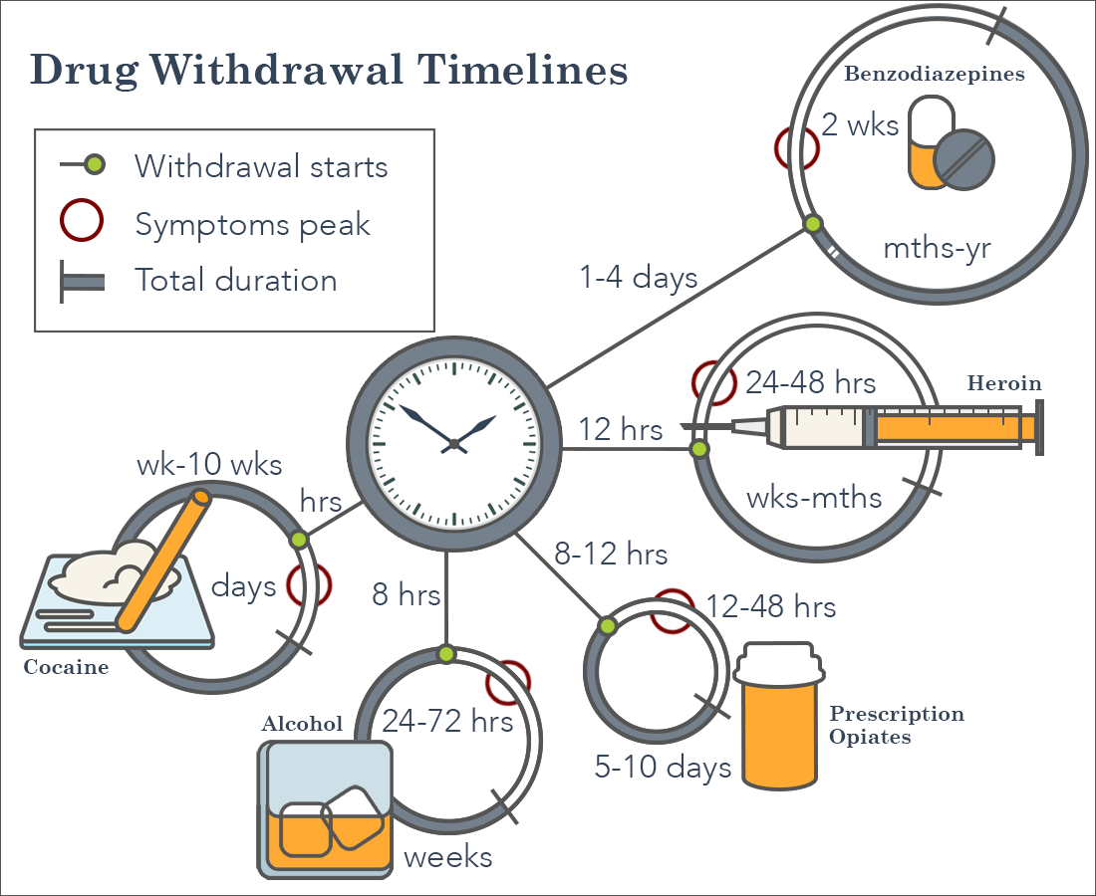

Slide 73


Depress-ANT Drugs
Alcohol
Client has been drinking at least 16 oz. of 80 proof alcohol per day or the equivalent of a 6 pack of beer per day.
Could be less for a smaller person

Slide 74
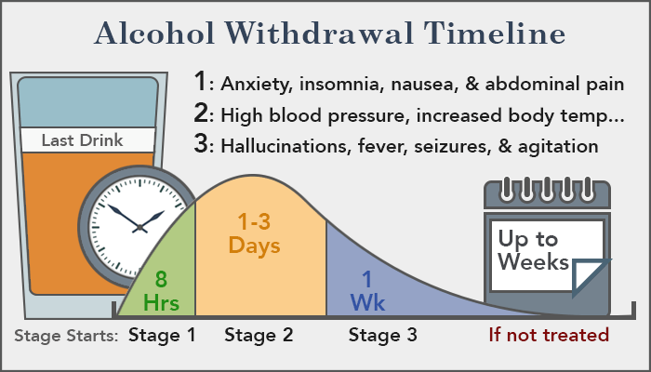

Slide 75
Signs of Alcohol Poisoning
Complicated or severe medical withdrawal has one or more elements of
Delirium
Hallucinations
Delusions
Seizures
Disturbances of body temperature, pulse, and blood pressure.

Slide 76

Signs of Withdrawal
Restlessness, irritability, anxiety, agitation
Anorexia (lack of appetite), nausea, vomiting
Tremor (shakiness), elevated heart rate, increased blood pressure
Insomnia, intense dreaming, nightmares
Poor concentration, impaired memory and judgment
Increased sensitivity to sound, light, and tactile sensations

Slide 77
Signs of Withdrawal
Hallucinations (auditory, visual, or tactile)
Delusions, usually of paranoid or persecutory varieties
Grand mal seizures (grand mal seizures represent a severe, generalized, abnormal electrical discharge of the major portions of the brain, resulting in loss of consciousness, brief cessation of breathing, and muscle rigidity followed by muscle jerking; a brief period of sleep, awakening later with some mild to even severe confusion, generally occurs)
Hyperthermia (high fever)
Delirium with disorientation with regard to time, place, person, and situation; fluctuation in level of consciousness

Slide 78
Mild Withdrawal from Alcohol
Mild alcohol withdrawal generally consists of anxiety, irritability, difficulty sleeping, and decreased appetite.

Slide 79
Moderate Withdrawal from Alcohol
Moderate alcohol withdrawal is defined more vaguely but represents some features of both mild and severe withdrawal.
Uncomplicated or mild to moderate withdrawal is characterized by restlessness, irritability, anorexia (lack of appetite), tremor (shakiness), insomnia, impaired cognitive functions, and mild perceptual changes.

Slide 80
Severe Alcohol Withdrawal
Severe alcohol withdrawal usually is characterized by obvious trembling of the hands and arms, sweating, elevation of pulse (above 100) and blood pressure (greater than 140/90), nausea (sometimes with vomiting), and hypersensitivity to noises (which seem louder than usual) and light (which appears brighter than usual). Brief periods of hearing and seeing things that are not present (auditory and visual hallucinations) also may occur. A fever greater than 101° F also may be seen, though care should be taken to determine whether the fever is the result of an infection.

Slide 81
Uncomplicated vs. Complicated
Uncomplicated or mild to moderate withdrawal is characterized by restlessness, irritability, anorexia (lack of appetite), tremor (shakiness), insomnia, impaired cognitive functions, and mild perceptual changes.
Complicated or severe medical withdrawal has one or more elements of delirium, hallucinations, delusions, seizures, and disturbances of body temperature, pulse, and blood pressure.

Slide 82
Interventions
Place in observation detoxification
Monitor vital signs every 2 hours
Push fluids (juice) diet as tolerated
After stable, encourage client to sit up
Limit noise (quiet environment)
If medical problems arise, refer for medical services

Slide 83
Interventions Severe Withdrawal from Alcohol and CNS depressants
Refer for medical services if:
Pulse higher than 120 bpm
Blood pressure greater than 160/110 mmHg
Temperature greater than 100 degrees Fahrenheit
Confused
Hallucinations, Delirium Tremens, Seizures

Slide 84
Interventions for all Alcohol abuse
Good nutrition
Plenty of fluids (juice)
Activity as permitted/tolerated

Slide 85
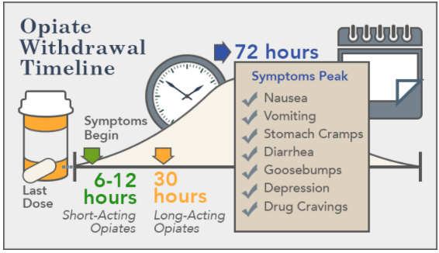

Slide 86
Opioids
“Opioids are highly addicting, and their chronic use leads to withdrawal symptoms that, although not medically dangerous, can be highly unpleasant and produce intense discomfort. All opioids (e.g., heroin, morphine, hydromorphone, oxycodone, codeine, and methadone) produce similar effects by interacting with endogenous (produced by the body itself) opioid receptors (that is, specific sites on cells where these substances bind to the cell). Opioid agonists stimulate these receptors and opioid antagonists block them, preventing their action.” (TIP 45)

Slide 87
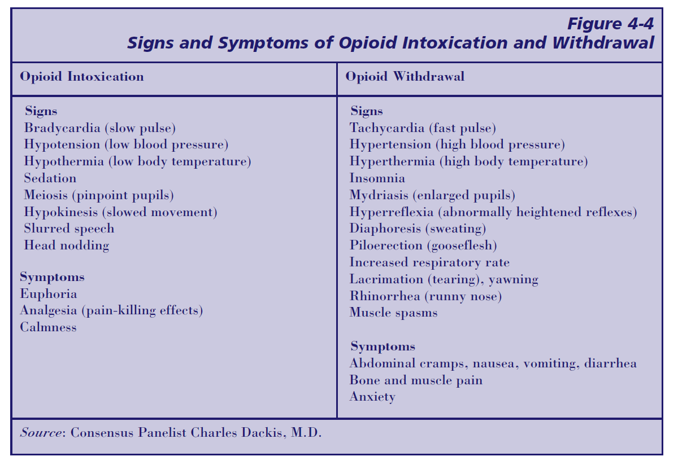

Slide 88
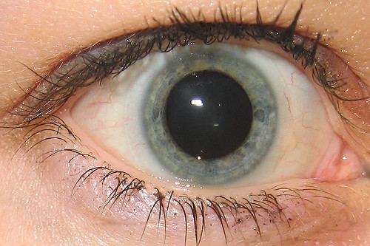
Narcotics Mild Withdrawal Symptoms
Goose bumps
Muscle twitching
Muscle and joint pain
Abdominal Discomfort
Dilated pupils
Anxiety

Slide 89
Interventions for Mild Narcotic Withdrawal
Place in observational detoxification
Monitor vital signs
Bed rest
Push fluids (Juices)
Diet as tolerated
If medical problems arise, refer for medical services with the doctor or hospital of their choice

Slide 90
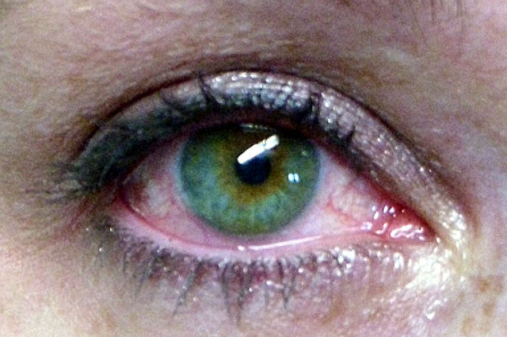
Narcotics Moderate Withdrawal Symptoms
Pulse rate is greater than 92 bpm
Blood pressure is higher than 140/90 mmHg
Temperature is 98-100.2 degrees Fahrenheit
Rhinitis (runny nose)
Lacrimation (Watery eyes)
Nausea
Extreme restlessness
Anorexia (no appetite)

Slide 91

Interventions for Moderate Narcotic Withdrawal
Place in observational detoxification
If medical problems arise, refer for medical services with the hospital or doctor of their choice.

Slide 92

Narcotics Severe Withdrawal Symptoms
Diarrhea
Vomiting
Dehydration
Hypotension (low blood pressure)
Hypoglycemia (low blood sugar)
Fetal position

Slide 93
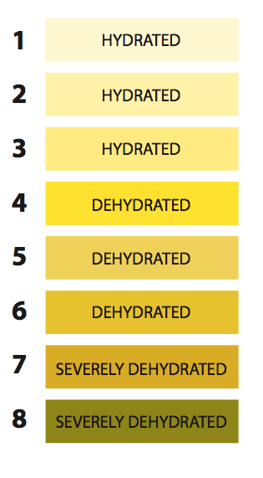
Severe Narcotic Withdrawal
WARNING: Dehydration is a medical emergency!
During dehydration the pulse elevates as the blood pressure drops or remains close to the same.
Follow emergency procedures as outlined in your facility policy and procedure manual.

Slide 94
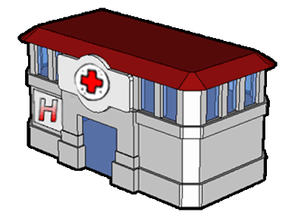
Narcotic Withdrawal Interventions
For severe Narcotic Withdrawal, refer immediately for medical services with the doctor or hospital of their choice.

Slide 95
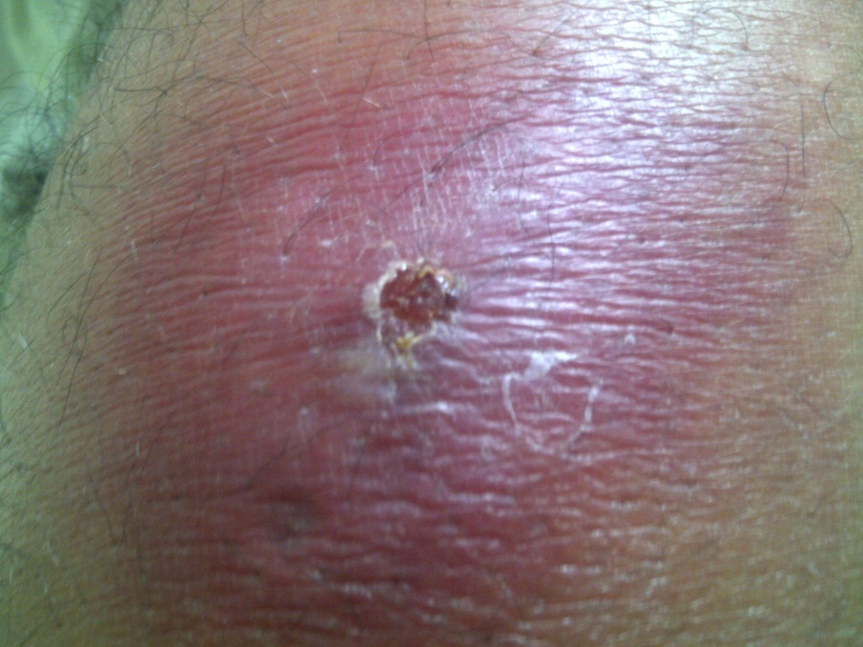
Narcotic General Considerations
If client is an IV drug user, monitor all injection sites for 72 hours for abscesses or cellulitis (inflammation of the subcutaneous tissues)
Monitor temperature; over 100.2 degrees Fahrenheit indicated an infection
Push fluids

Slide 96

Stim-u-ANTS Withdrawal
Drugs that stimulate or increase thinking, feeling, and behavior.

Slide 97
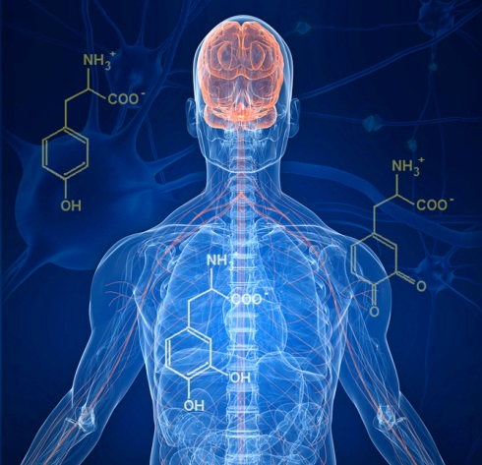
Stim-U-Ant Examples
Tobacco
Amphetamines
Methamphetamines
Cocaine

Slide 98
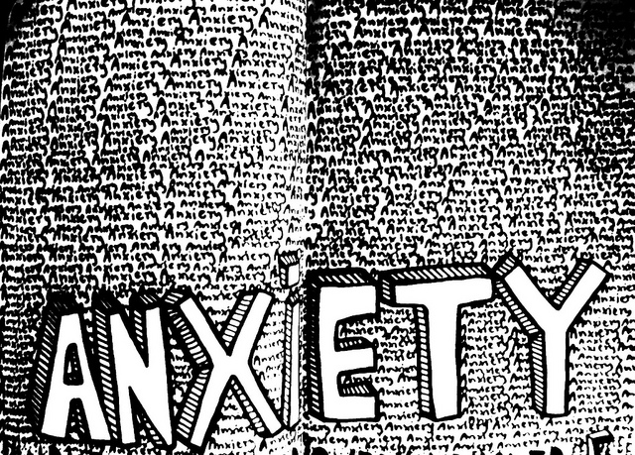
Stimulants Mild Withdrawal Symptoms
Anxiety
Lack of energy
Increased appetite

Slide 99
Interventions for Mild Stimulant Withdrawal
Place in observational detoxification
Monitor Vital Signs
Bed Rest
Push fluids (juices)
Diet as tolerated
If medical problems arise, refer for medical services

Slide 100

Stimulants Moderate to Severe Withdrawal Symptoms
Hyper-somnolence (very deep sleep)
Intense drug craving
Muscle aches and pain
Abdominal pain
Severe depression
Fatigue
Anxiety

Slide 101
Interventions for Moderate to Severe Stimulant Withdrawal
Place in observational detoxification
Monitor Vital Signs
Bed Rest
Push fluids (juices)
Diet as tolerated
If medical problems arise or profound depression occurs, refer for medical services

Slide 102

Confuse-ANT Withdrawal
Drugs that confuse or distort thinking, feeling or behavior

Slide 103
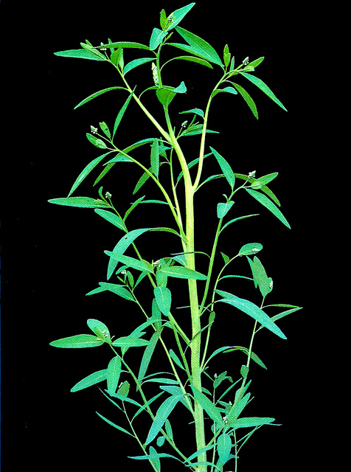
Confuse-Ant Examples
Marijuana
PCP
LSD
Ketamine
MDMA-Ecstasy
Inhalants

Slide 104

Marijuana Withdrawal Symptoms
Irritability
Anxiety
Physical tension
Decreases in appetite and mood

Slide 105
Ecstasy Withdrawal Symptoms
Depression
Confusion
Anxiety
Cravings
Agitation
Paranoia
Insomnia
Fatigue
Difficulty concentrating
Loss of appetite
Memory Problems
Changes in self perception
Notes:
https://www.addictioncenter.com/drugs/ecstasy/withdrawal-detox/

Slide 106
Interventions for Confus-ANT Withdrawal Symptoms
Place in observational detoxification
Monitor Vital Signs
Bed Rest
Push fluids (juices)
Diet as tolerated
If medical problems arise, refer for medical services

Slide 107
Documentation
If you see it, feel it, smell it, hear it, document it!
Do not leave blank spaces. If there is a blank, it’s there for a reason.
Use of N/A , none, or zero. Be attentive to the actual question being asked.
Refrain from using repetitive statements.
Don’t rely on check boxes to tell the story, describe when appropriate.
Does it match?
Proofread.
Document as soon as possible.

Slide 108
Client File Contents
Proof of client identity
A signed Voluntary Admission Agreement; or court order
Conditions of Admission Agreement
Financial Assessment (verification of income)
Withdrawal Risk Assessment
Authorization for release of information
Personal property inventory (signed by client)
Detoxification (Stabilization) plan
Aftercare (Discharge) plan
RDS (progress) notes
Vital Signs Sheet
Notes:
DS16

Slide 109

Withdrawal Risk Assessment
Initiated on Admission
Completed and filed within 4 hours
If an emergency prevents documentation within four hours;
Explain circumstances in client records and obtain information as soon as possible.

Slide 110
Withdrawal Risk Assessment
It will include:
Substance use/abuse history
Current Detoxification Level determination
Past psychiatric treatment
Past alcohol and other drug treatment
Significant medical history
Current health status
Current Medications
Known food allergies
Known drug allergies
Current living situation
Current employment situation
Current emotional state and behavioral functioning

Slide 111

Detoxification (Stabilization) Plan
A complete and signed plan will be filed in client record within 8 hours of admission
The plan will be reviewed and revised if necessary; every 24 hours; or more often, should the client need change significantly.
Stabilization Plan/Detox Plan signed by appropriately credentialed staff and client (which can be late if client impaired as long as you document why). This plan must be completed and in the file within eight (8) hours of admission.
This plan is to be reviewed no later than every 24 hours, but can be reviewed more often if necessary. If there is a need to update the plan, then updates can be completed and documented as often as necessary.

Slide 112

Detoxification (Stabilization) Plan
The RDS, LPN, LPTN, RN, APRN or MD will sign the detoxification plan along with the client unless medically incapable; in this case the staff will
Explain the circumstances in the client record
Obtain the signature as soon as possible

Slide 113

Medication Record
Medication records including all previously prescribed meds, including type, amount/dose, route, frequency, related medical condition, prescribing physician, and COUNT, if they are bringing their own medications.
Although not mentioned in the detox standards, licensure standards do require that over-the-counter meds are also identified and documented.
Notes:
DS 15

Slide 114

Authorization to Release Information
Authorization(s) to Release Confidential Information, as appropriate.

Slide 115

Personal Property Inventory
Signed by staff or authorized agent, and client
To avoid liability, use general terms to describe valuables; i.e. ring with yellow band and white stone instead of diamond ring

Slide 116

Vital Signs
Vital Signs will be documented at least every 2 hours, after initial intake, until…
Client is experiencing symptoms no higher than mild withdrawal for 8 hours and
Vital signs are within normal limits for 8 hours
Notes:
DS7

Slide 117

Aftercare (Discharge) Plan
Initiated at admission
State the client needs
Goals
Objectives
Target dates

Slide 118
Progress notes while client is in detoxification will include…
The client’s physical condition as observed by staff
Client’s statements about their condition
Client’s statements about their needs
The client’s mood and behavior as observed by staff
Information about the client’s progress, or lack of progress, in relation to detoxification goals.

Slide 119
RDS Progress Notes
The use of abstract terms, technical jargon and slang are to be avoided in the progress notes and in treatment plans.
Progress notes include ALL of the following:
Client’s physical condition observed by staff
(eg. vitals, sweating, vomiting, resting peacefully)
b. Client’s statement about their condition/symptoms
(eg. “I feel like puking” or “I’m sleepy” or “I’m anxious”)
c. Client’s statement about their needs
(eg. “I need something for my headache” or
“I’m hungry”)
Notes:
DS16

Slide 120
RDS Progress Notes
Detox files must contain:
d. Client’s mood and behavior
(eg. Client is anxious as evidenced by rapid speech/respirations and repeating herself.)
e. Any medications that are prescribed
(eg. Client began Librium protocol at 1600, or client requested ibuprofen 200 mg for headache.)
f. Info/description about client’s progress or lack of progress toward stabilization/detox goals.
(eg. Client continues to refuse food and fluids and appears dehydrated as evidenced by report of dry mouth and muscle cramps.)
Notes:
DS16

Slide 121

Documentation
Document before leaving the facility
Do not document tomorrow
Do not let someone else document for you
Do not place copies of your original documentation in a file.

Slide 122
Thank you! Feel free to contact me at jennifer.shuler@dhs.arkansas.gov Office: 501-396-6347 Cell: 501-416-9401

