Slide 1
Module 5: Outreach Overview
Health & Nutrition Programs
USDA is an equal opportunity provider, employer, and lender.

Slide 2
Our mission….
to increase food security and reduce hunger by providing children and low-income people access to food, a healthy diet and nutrition education in a way that supports American agriculture and inspires public confidence.

Slide 3
Arkansas Food Security concerns…..
More than 200,000 children in Arkansas are at risk of hunger and not getting the food they need to lead healthy, active lives.
More than 28% of children in Arkansas live in poverty.
Nearly 30% of households with children in Arkansas struggle to afford enough food for themselves and their families.
Many children lose access to breakfast and lunch when school is not in session.

Slide 4
CACFP
CACFP
The Child and Adult Care Food Program (CACFP) provides reimbursements for nutritious meals and snacks to eligible children and adults who are enrolled for care at participating childcare centers, day care homes, and adult day care centers.
2021: 331 Sponsors
1411(Highest) Child Sites/51 Adult Sites)
CACFP At-Risk
At-Risk Afterschool Meals component of the Child and Adult Care Food Program (CACFP) offers Federal funding to Afterschool Programs that serve a meal or snack to children in low-income areas.
2021: 74 Sponsors (272 Sites)

Slide 5
SFSP
The Summer Food Service Program (SFSP) reimburses providers who serve free healthy meals to children and teens in low-income areas during the summer months when school is not in session.
2021:
72 Sponsors/960 sites

Slide 6
NSLP
The National School Lunch Program (NSLP) operates in public and nonprofit private schools and residential childcare institutions. It provides nutritionally balanced, low-cost or no-cost lunches to children each school day. The program was established under the Richard B. Russell National School Lunch Act, signed into law by President Harry Truman in 1946.
2021: 24 Programs

Slide 7
The DCCECE Commodity Distribution Unit
Allocates USDA dollars to be spent on Food Distribution based on previous meals served
USDA dollars can be used to purchases commodities from a list of available USDA foods. Examples: meats, vegetables and fruits, processing foods, and DOD Fresh Fruits and Vegetables
CACFP
CACFP at Risk
SFSP
NSLP (both DHS and ADE)

Slide 8
Commodity Distribution Unit - Continued
USDA Foods Processing
Administering Agency: DCCECE Commodity Distribution Unit
Allows State Distributing Agencies (CDU) and eligible Recipient Agencies such as school districts to contract with commercial food processors to convert raw bulk USDA foods into more convenient, ready-to-use end products.
The Emergency Food Assistance Program (TEFAP):
Administering Agency: DCCECE Commodity Distribution Unit.
Assists in supplementing the diets of low-income Americans by providing them with emergency food assistance at no cost.
Commodity Supplemental Food Program (CSFP):
Administering Agency: DCCECE Commodity Distribution Unit
Assists to improve the health of low-income persons at least 60 years of age by supplementing their diets with nutritious USDA foods.

Slide 9
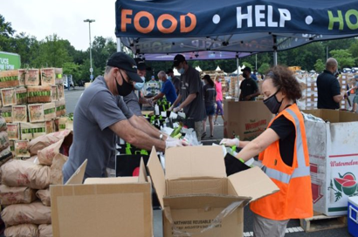
Commodity Distribution Unit - Continued
USDA Foods during Disasters
Administering Agency: DCCECE Commodity Distribution Unit
As part of the National Response Framework, USDA Food Distribution has the primary responsibility of supplying food to organizations like Red Cross, Salvation Army for mass/congregate feeding or household distribution.
State Food Purchasing Program
Administering Agency: AR DHS Division of County Operations (DCO)/AR Hunger Relief Alliance
Provides approximately $1 million to the AR Hunger Relief Alliance through the Tobacco Tax to purchase food and provide funds for capacity building grants to member agencies.
Coming Soon!!
Farm to Food Bank Program
Administering Agency: DCCECE Commodity Distribution Unit
As part of the TEFAP program this will provide additional administrative funds to food banks to cover farmers costs of picking and packaging produce for food bank distribution.

Slide 10
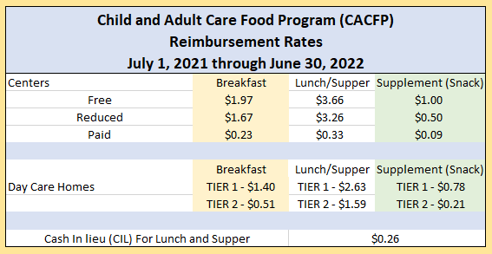

Slide 11
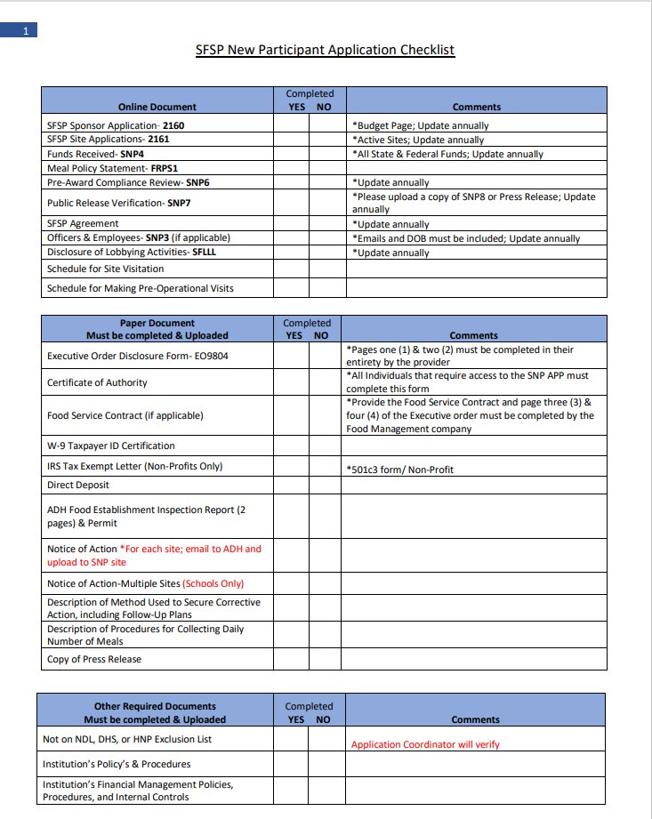
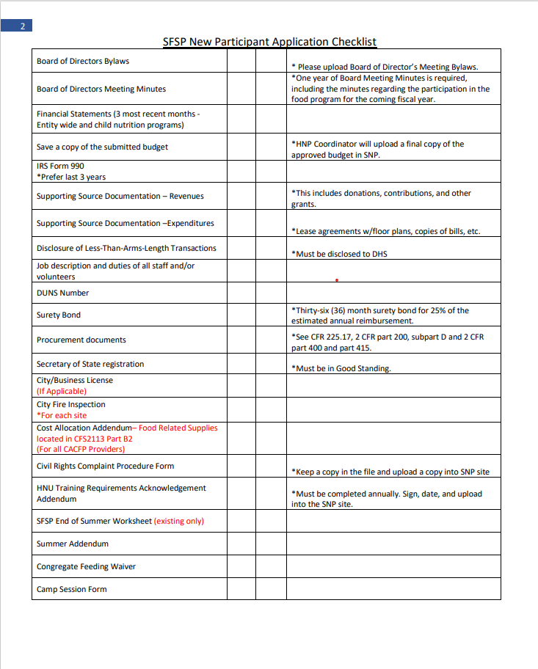
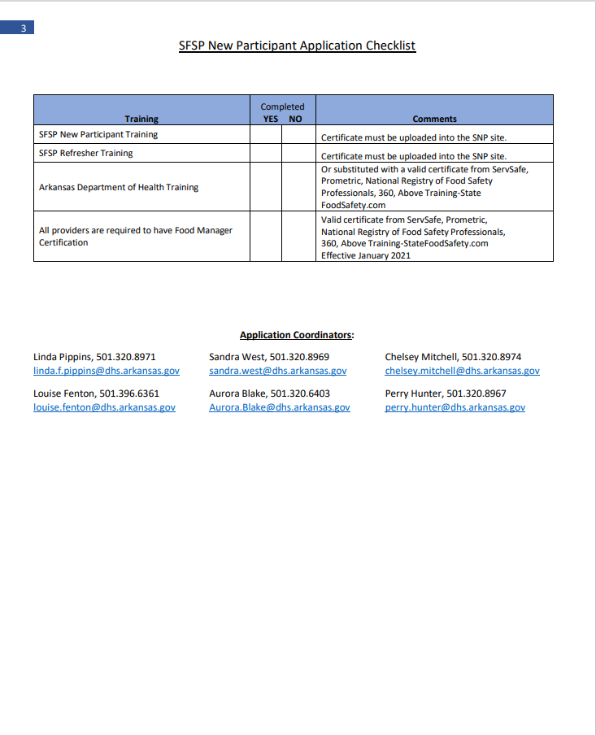
Application TEAM
30 Days

Slide 12
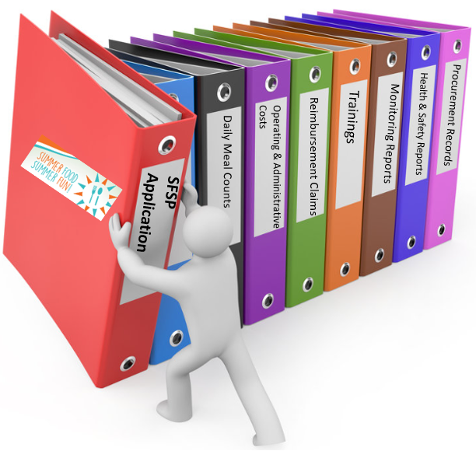
Review TEAM
Required Documentation for Review
Attendance Roster
Enrollment Forms for Children
Income Eligibility Forms (FRP/2016) for Children
Income Eligibility Forms (SNP-10A) for Adults
Obligation to Serve Infants Forms
Production Records (meal documentation records)
Itemized Receipts for all CACFP Expenditures (food/milk, allowable non-food, administrative costs/salaries, Procurement)
Meal Count Sheets (contracted meals)
Vendor Menus (contracted meals)
Vendor Invoices (contracted meals)

Slide 13
Training TEAM
Application Training- 3 hours
New Participant Training (All Programs) - 6 hours
Online Refresher Training (All Programs) - 2 hours
1-on-1 Technical Assistance – As requested
On-Site Special Topic Training for Providers – As requested

Slide 14
USDA Non-Discrimination Statement
In accordance with Federal civil rights law and U.S. Department of Agriculture (USDA) civil rights regulations and policies, the USDA, its Agencies, offices, and employees, and institutions participating in or administering USDA programs are prohibited from discriminating based on race, color, national origin, religion, sex, gender identity (including gender expression), sexual orientation, disability, age, marital status, family/parental status, income derived from a public assistance program, political beliefs, or reprisal or retaliation for prior civil rights activity, in any program or activity conducted or funded by USDA (not all bases apply to all programs). Remedies and complaint filing deadlines vary by program or incident.
Persons with disabilities who require alternative means of communication for program information (e.g., Braille, large print, audiotape, American Sign Language, etc.) should contact the responsible Agency or USDA's TARGET Center at (202) 720-2600 (voice and TTY) or contact USDA through the Federal Relay Service at (800) 877-8339. Additionally, program information may be made available in languages other than English.
To file a program discrimination complaint, complete the USDA Program Discrimination Complaint Form, AD-3027, found online at How to File a Program Discrimination Complaint and at any USDA office or write a letter addressed to USDA and provide in the letter all of the information requested in the form. To request a copy of the complaint form, call (866) 632-9992. Submit your completed form or letter to USDA by:
(1) mail: U.S. Department of Agriculture, Office of the Assistant Secretary for Civil Rights, 1400 Independence Avenue, SW, Washington, D.C. 20250-9410
(2) fax: (202) 690-7442
(3) email: program.intake@usda.gov
USDA is an equal opportunity provider, employer, and lender.
Arkansas Special Nutrition Program Website: https://dhs.arkansas.gov/dccece/snp/WelcomeSNPM.aspx

Slide 15
www.facebook.com/ArkDHS
@ARHumanServices
@arkansasdhs
Arkansas DHS
Social Media

