Slide 1
Module 2: Crediting Handbook for the Child and Adult Care Food Program
The 5 Creditable Components
USDA is an equal opportunity provider, employer, and lender.

Slide 2
Goal of USDA’s Child & Adult Care Food Program:
To improve the health and nutrition of children and adults in the program while promoting the development of good eating habits through nutrition education.

Slide 3
Crediting Food in the CACFP
Grains, Fruits, Vegetables, Dairy, &
Meat/Meat Alternates

Slide 4
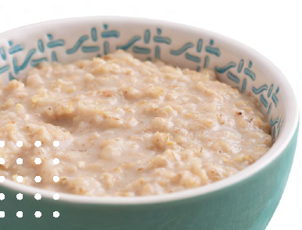
GRAINS

Slide 5
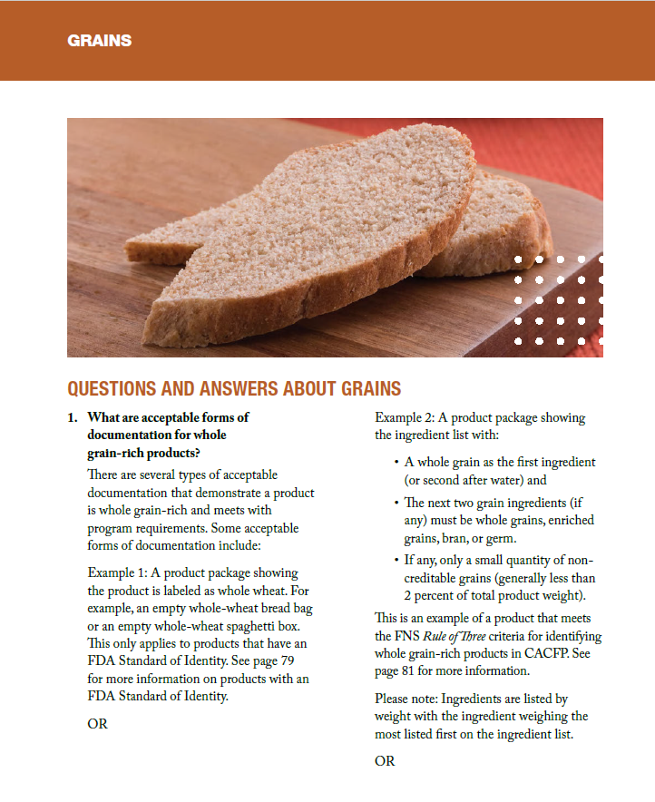
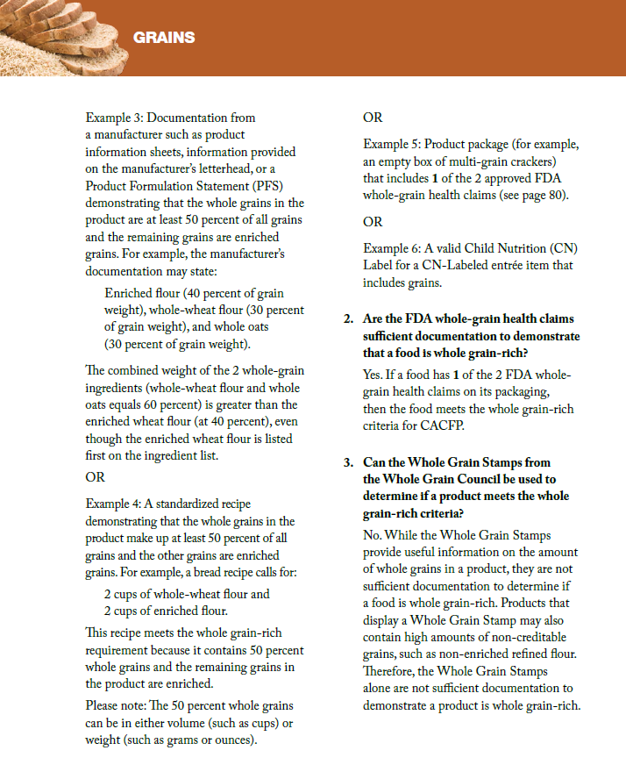

Slide 6
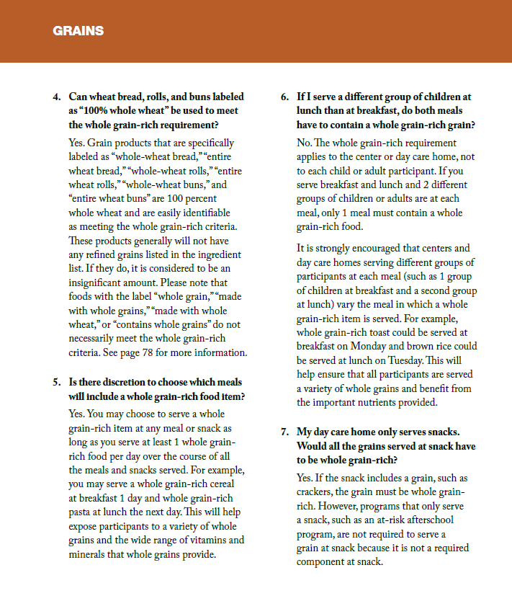
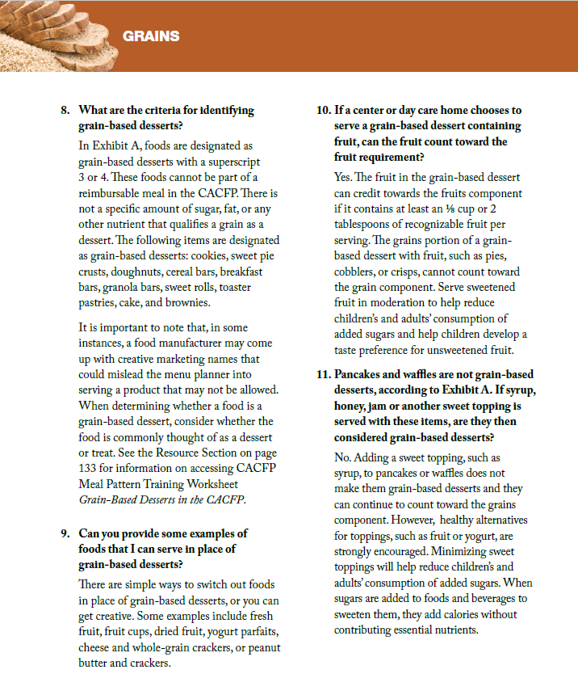

Slide 7
Rule of 3 Method: How will you determine if your product is whole grain rich? You will need to look at the nutrition label and list of ingredients:
Best Practice is to provide at least two servings of whole grain-rich grains per day, but you are only required to serve at least one whole grain item each day.
You can still serve fortified and enriched grains on your menu for reimbursement, but they do not count towards the whole grain requirement.
1. The first ingredient (or second after water) in the food is whole grain
2. The second grain ingredient (if any) is a whole grain, enriched, bran, or germ.
3. The third grain ingredient (if any) is also a whole grain, enriched, bran, or germ.
What to Watch Out For: The term “whole grain” “multi-grain” stamped on the package cannot be used to identify a whole grain-rich food. You must look at the ingredients on the label.
AND
AND

Slide 8
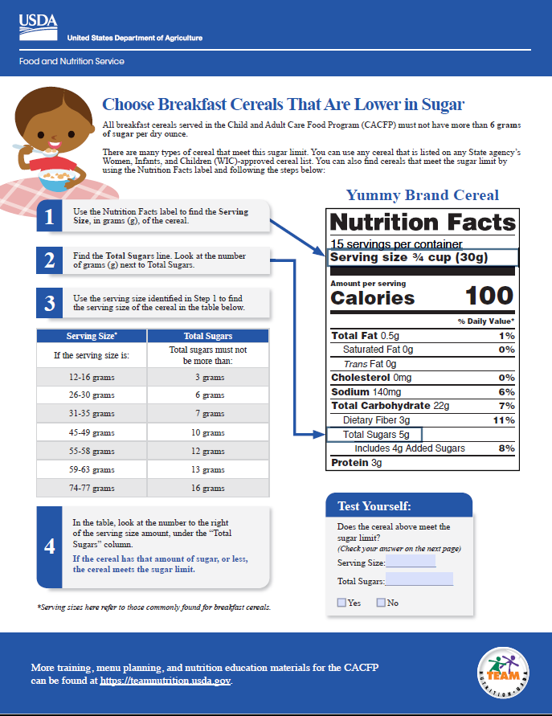
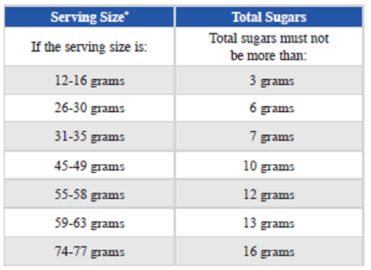
No more than 6 grams of sugar per dry ounce

Slide 9
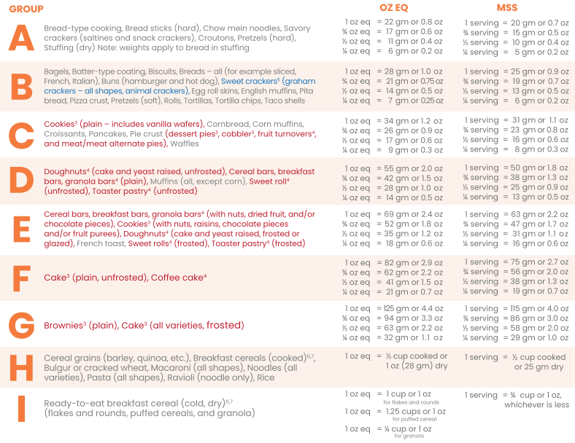
Black: Creditable for CACFP, NSLP, & SFSP
Red: Not Creditable for CACFP
Blue: Reinstated as creditable item for CACFP

Slide 10
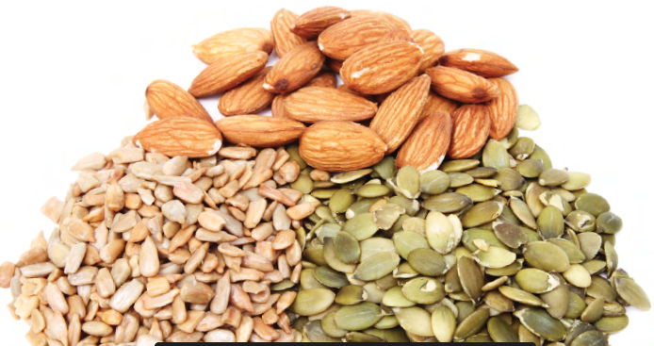
Meats/ Meat Alternates

Slide 11
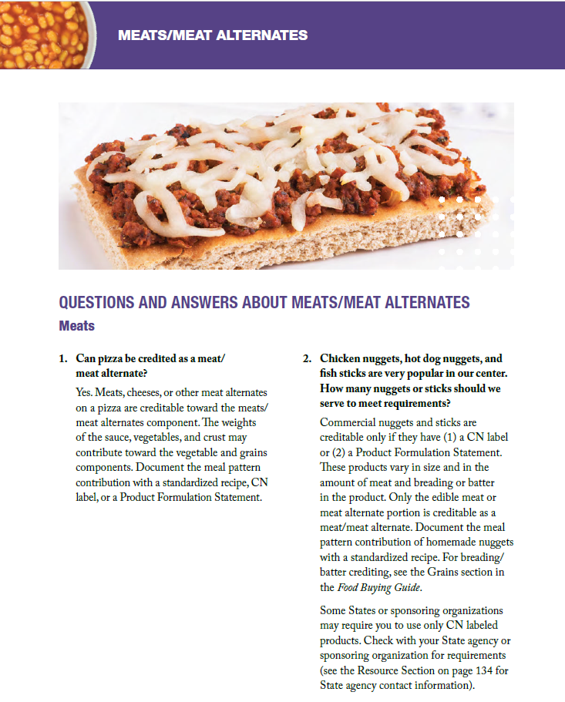
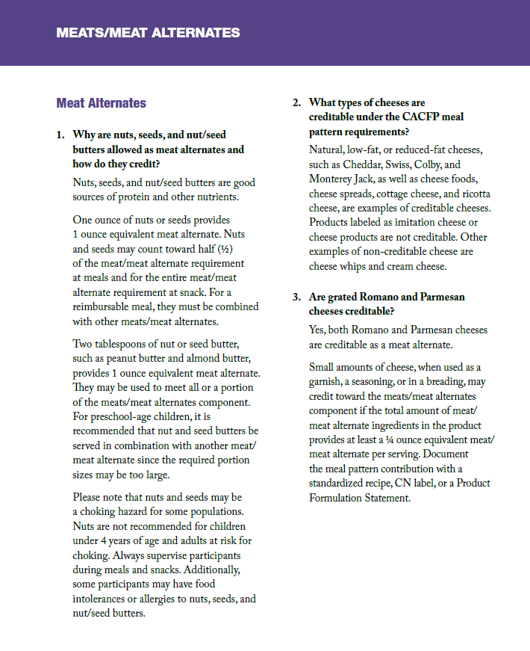

Slide 12
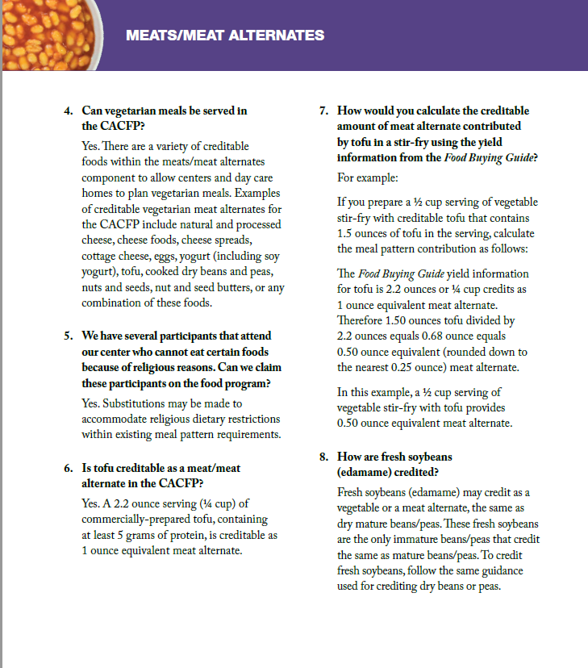
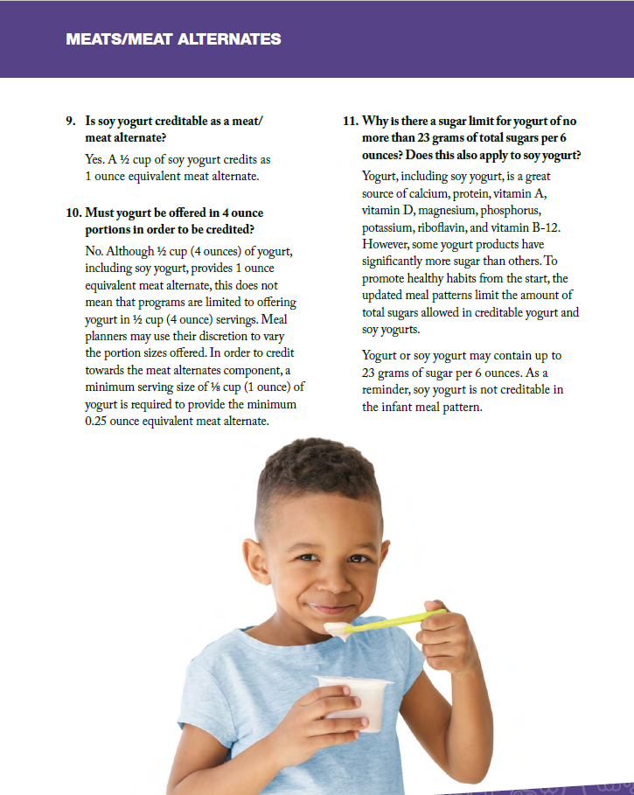

Slide 13
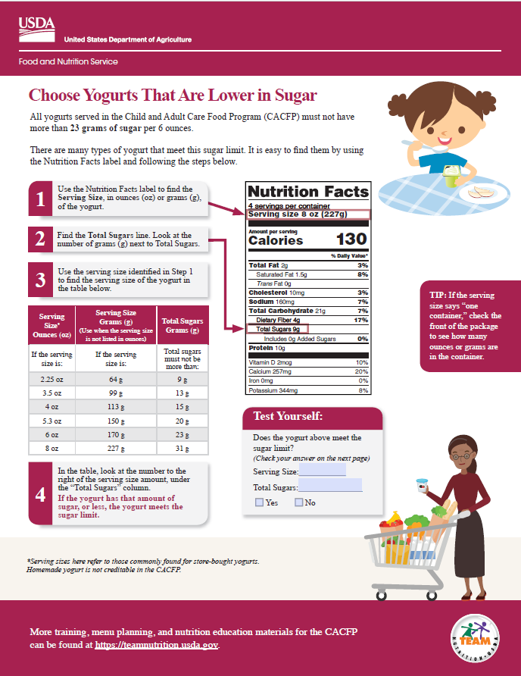
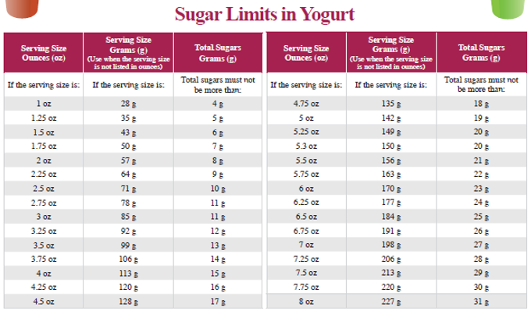
Yogurt must contain no more than 23 grams of sugar per 6 ounces.
“Adapted from U.S. Department of Agriculture, Team Nutrition. USDA does not endorse any products, services, or organizations. Provided by Arkansas Department of Human Services”

Slide 14
Notes:
First ingredient must be meat or 2nd ingredient followed by water
Best practice is to have Child Nutrition (CN) Label
Best practice – limit processed meats to one serving per week

Slide 15
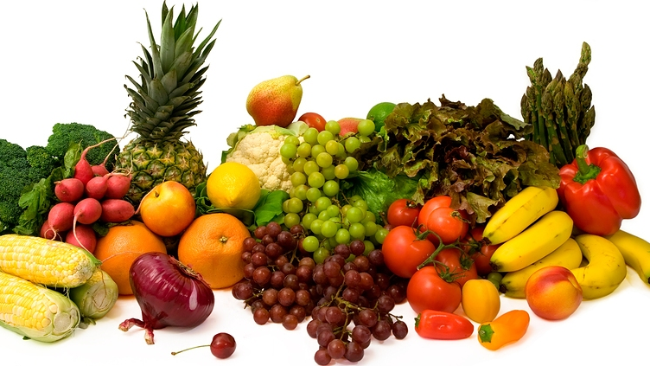
FRUITS & VEGETABLES

Slide 16
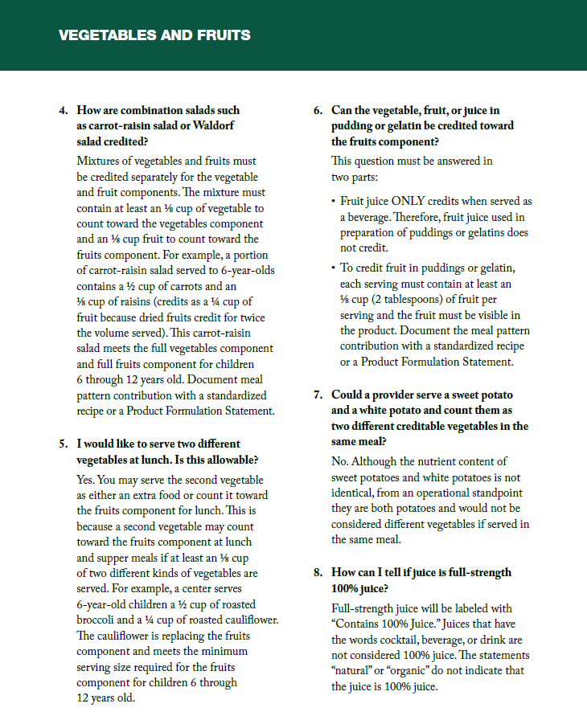

Slide 17
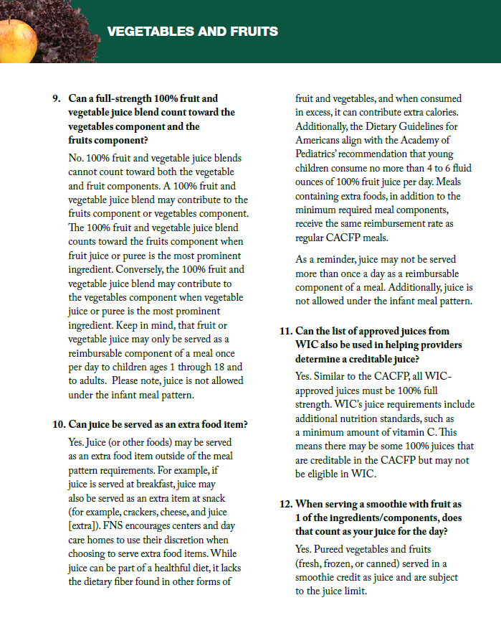
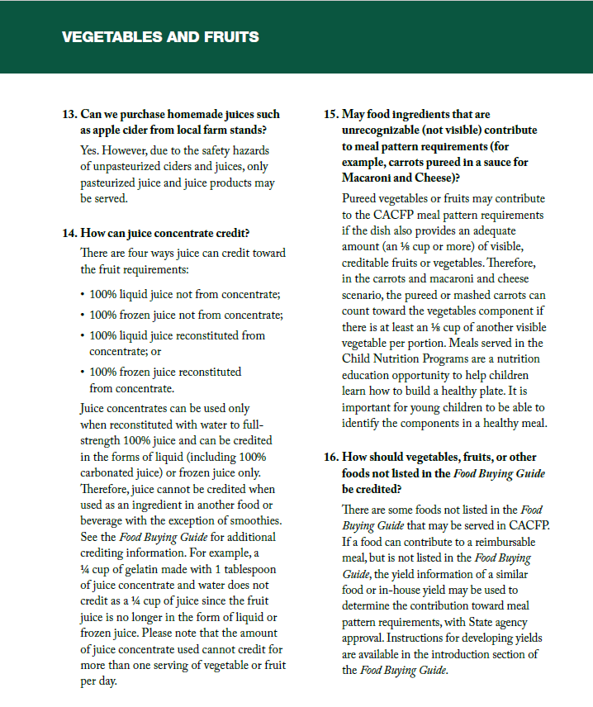

Slide 18
Vegetable and fruit basics
A vegetable can meet the entire fruit requirement at lunch and supper - such as green peas & carrots however you cannot serve two fruits at lunch/supper.
When more than one vegetable is served at lunch or supper, you must use two different types
Fruits may be served fresh, frozen, canned or dried
100% pasteurized fruit juice may only be served once per day but can be served every day of the week

Slide 19
DAIRY
Fluid Milk

Slide 20
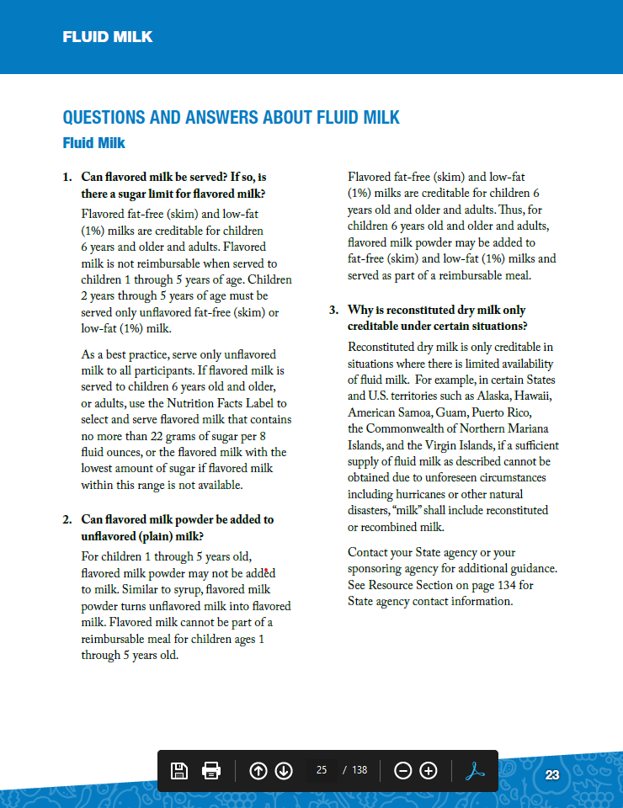
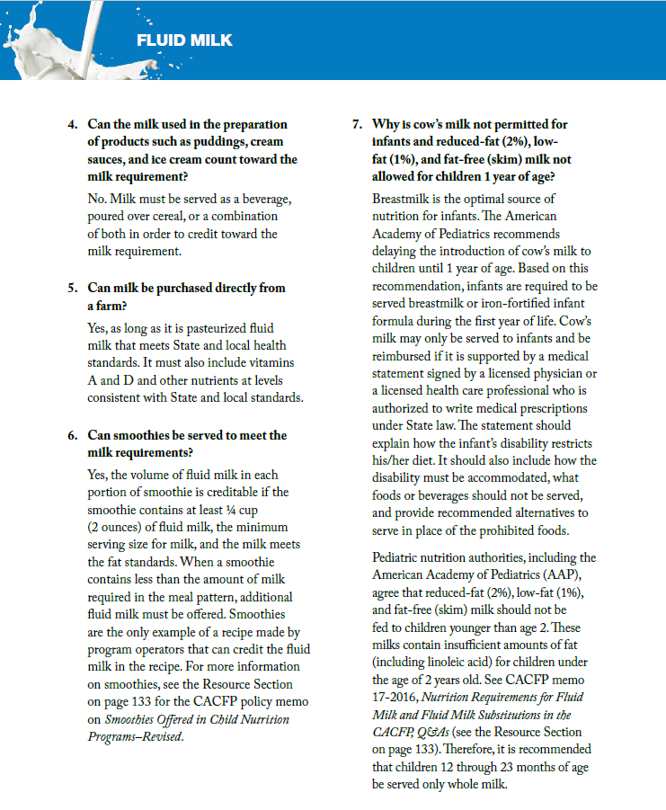

Slide 21
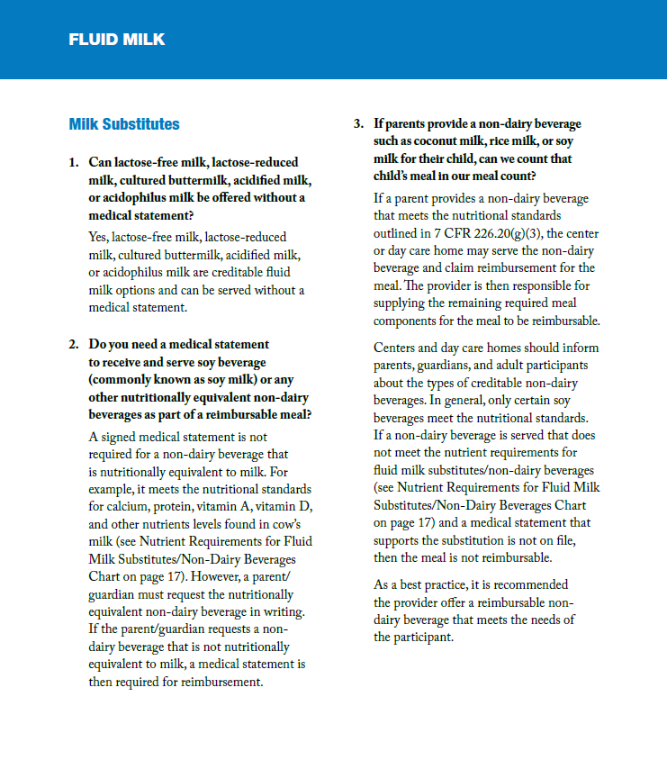
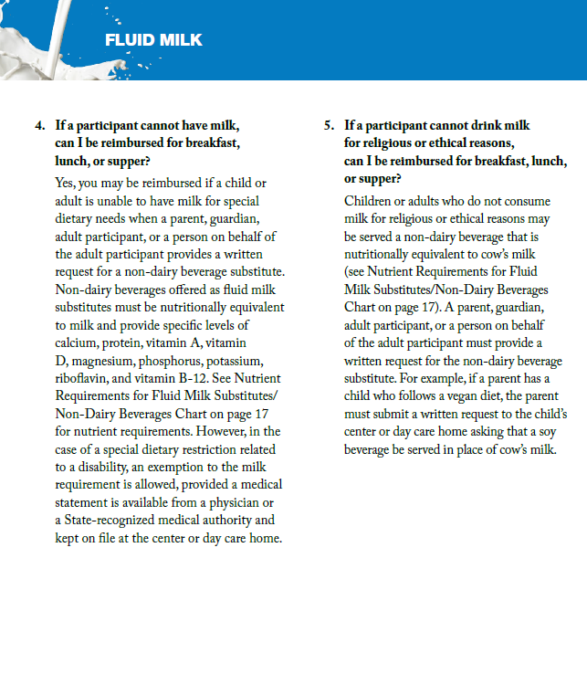

Slide 22
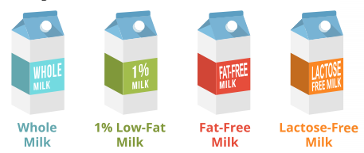
Creditable Milk
Note: Soy Milk is also creditable in CACFP
Flavored milk cannot be part of the reimbursable meal or snack for children 5 years old and younger.
Homemade flavored milk by adding flavored straws, syrups, and powders to unflavored milk cannot be part of a reimbursable meal or snack.
For Adults only:
Yogurt may be served in place of milk once per day and a serving of milk is optional at supper. 6 oz(weight) or ¾ cup (volume) of yogurt may be used the equivalent of 8 oz of fluid milk once per day when yogurt is not served as a meat alternative in the same meal.

Slide 23
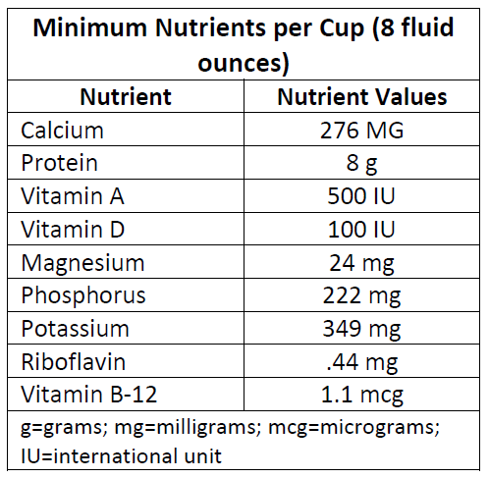
The CACFP requires that fluid milk substitutes be nutritionally equivalent to milk and meet the following nutritional standards (7 CFR 210.10(m)(3)).
A FINAL UDSA RULE addressed the substitution of fluid milk for children who’s non-disabling allergies, culture, religion, or ethical beliefs do not allow consumption of cows milk.
Parents may request in writing a fluid milk substitute
A Medical Exception Statement signed by a physician is NOT required for this type of request (mild substitution ONLY).

Slide 24
Milk Requirements and Transitions:
Newborn through 11 months old must be served Breastmilk or Iron-Fortified Formula * Breastmilk is allowed at any age in CACFP
*iron-fortified formula may be served to children between the ages of 12 months to 13 months help with the transition to whole milk.
Unflavored whole milk and unflavored reduce-fat (2%) milk may be served to children between the ages of 24 and 25 months to help with the transition to fat-free (skim) or Low-fat (1%)

Slide 25
USDA Non-Discrimination Statement
In accordance with Federal civil rights law and U.S. Department of Agriculture (USDA) civil rights regulations and policies, the USDA, its Agencies, offices, and employees, and institutions participating in or administering USDA programs are prohibited from discriminating based on race, color, national origin, religion, sex, gender identity (including gender expression), sexual orientation, disability, age, marital status, family/parental status, income derived from a public assistance program, political beliefs, or reprisal or retaliation for prior civil rights activity, in any program or activity conducted or funded by USDA (not all bases apply to all programs). Remedies and complaint filing deadlines vary by program or incident.
Persons with disabilities who require alternative means of communication for program information (e.g., Braille, large print, audiotape, American Sign Language, etc.) should contact the responsible Agency or USDA's TARGET Center at (202) 720-2600 (voice and TTY) or contact USDA through the Federal Relay Service at (800) 877-8339. Additionally, program information may be made available in languages other than English.
To file a program discrimination complaint, complete the USDA Program Discrimination Complaint Form, AD-3027, found online at How to File a Program Discrimination Complaint and at any USDA office or write a letter addressed to USDA and provide in the letter all of the information requested in the form. To request a copy of the complaint form, call (866) 632-9992. Submit your completed form or letter to USDA by:
mail: U.S. Department of Agriculture, Office of the Assistant Secretary for Civil Rights, 1400 Independence Avenue, SW, Washington, D.C. 20250-9410;
(2) fax: (202) 690-7442; or
(3) email: program.intake@usda.gov.
USDA is an equal opportunity provider, employer, and lender.
Arkansas Special Nutrition Program Website:
https://dhs.arkansas.gov/dccece/snp/WelcomeSNPM.aspx

Slide 26
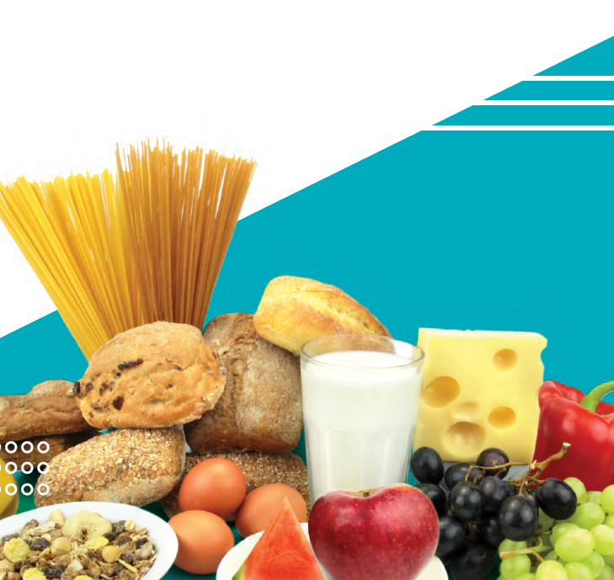
www.facebook.com/ArkDHS
@ARHumanServices
@arkansasdhs
Arkansas DHS
Social Media

