Slide 1
Maternal Life 360

Slide 2
Our Mission
“To provide Christ-like healing to the community through education, treatment and health services.”

Slide 3
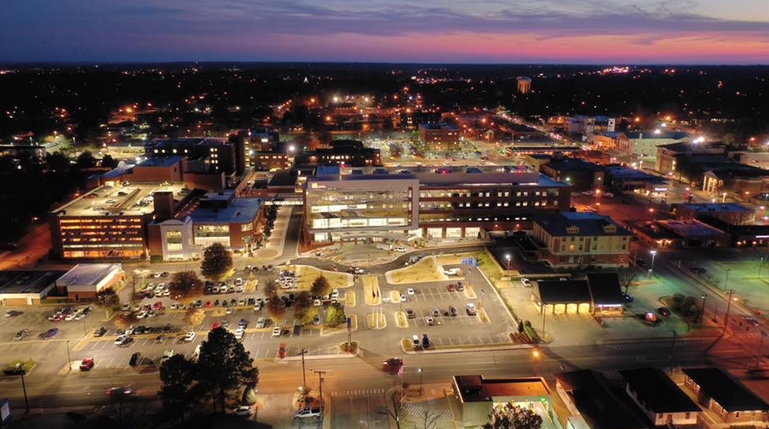
St. Bernards Healthcare
124 Year History in Northeast Arkansas
St. Bernards Medical Center is licensed for 454 beds
  Highest Level Trauma Center in Region
Medical Staff Members: 304
  Specialties Represented: 43
Employees: 4,677
  Cities employed from: 165
  Largest Employer in the Region

Slide 4
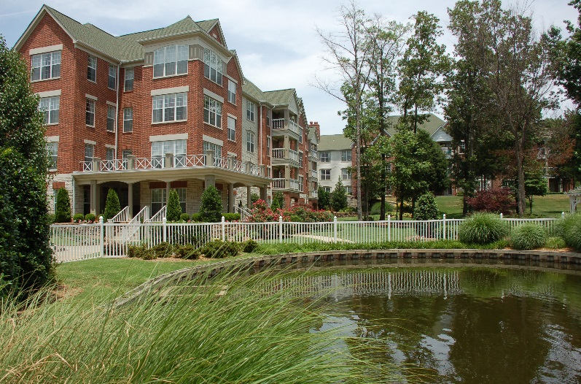
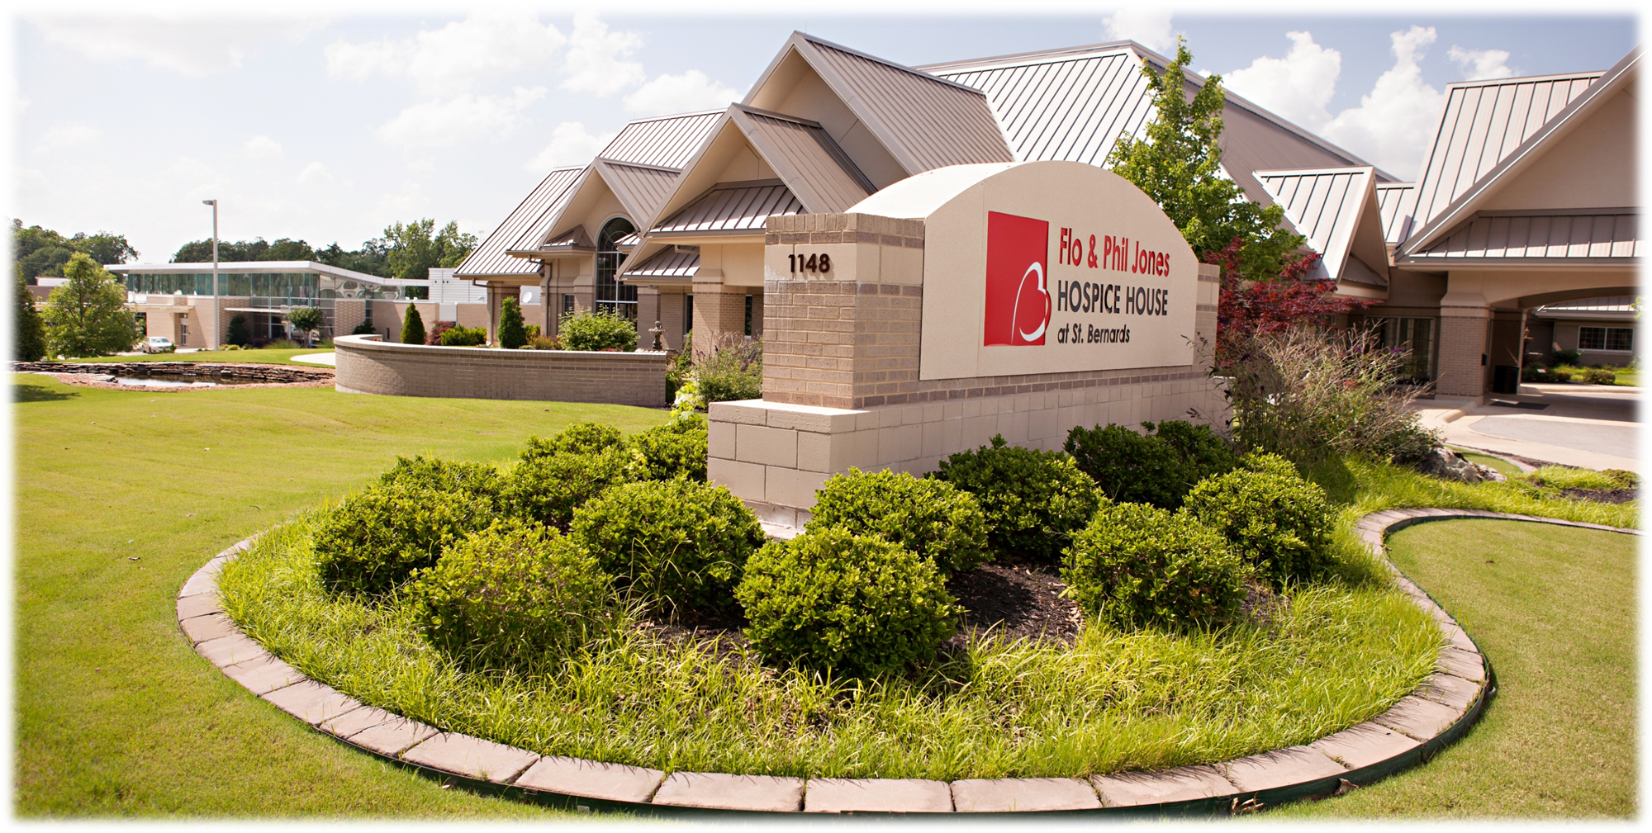
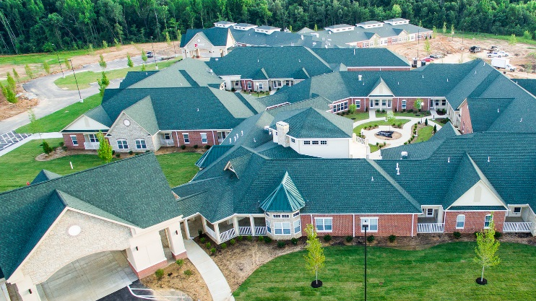
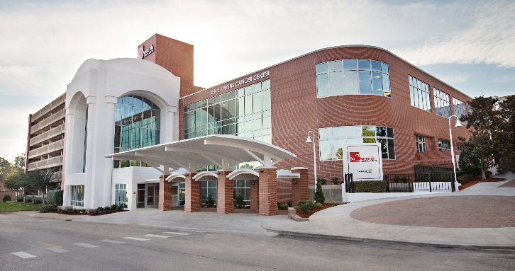
St. Bernards Healthcare Scope
Hospitals
  Acute
  Rural Hospitals
  Behavioral Health
  Inpatient Rehab
Physicians
Housing
  Retirement Communities
Services
  Cancer Services
  Heart Care Services
  Women’s & Children’s Services
  Senior Services
People
Notes:
Employees: 4,270

Slide 5
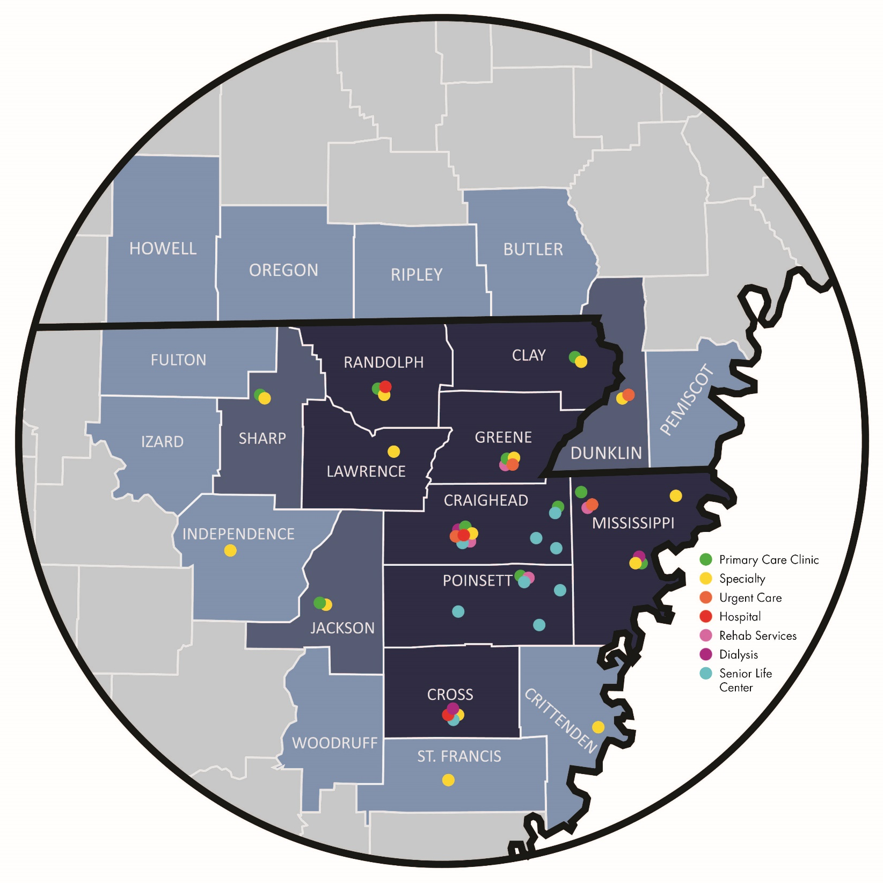
St. Bernards
Service Area

Slide 6
Delivery Rates in our Region
Notes:
These deliveries are based off of deliveries in the month of October. We are seeing an increase with 40% of our deliveries being sent from our pregnancy clinic. This is what we see on average monthly, but in September we delivered 174 babies. This exceeded every month since at least 1995. We deliver 1,473 babies this past year.
AMMC has increased based on additional coverage
NEA has decreased based on their provider coverage
Great Rivers and Unity have both experienced declines
Forrest City Medical Center has seen an increase in patients that otherwise would have gone to NEA

Slide 7
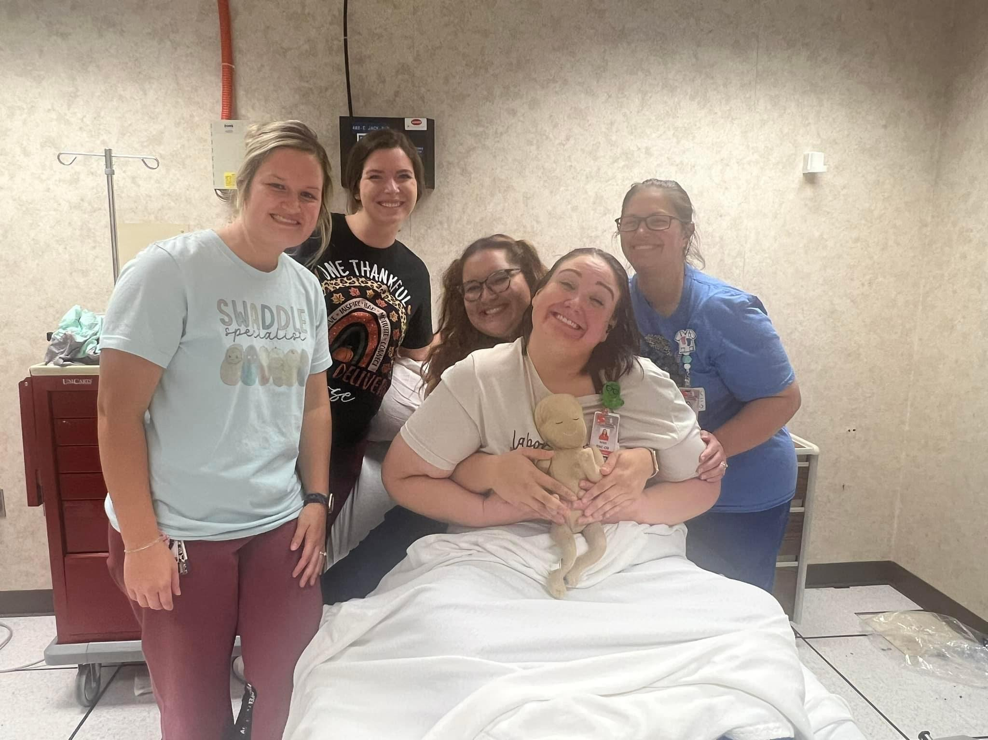
Maternal Safety
Staffed with 50 specialty trained RNs to provide one on one care
9 nurses with a national certification in maternal care
Extensive orientation and ongoing education
Every nurse has ACLS,NRP, STABLE, and AWHONN fetal monitoring
NRP instructor, AWHONN EFM instructor, AWHONN Ops instructor, Spinning Babies workshop hosts, Arkansas’s first peanut ball ambassador

Slide 8
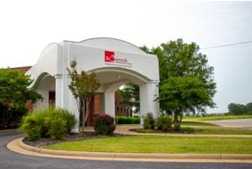
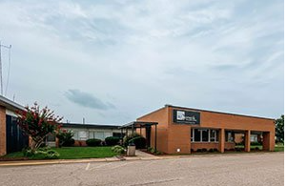
St. Bernards Pregnancy Clinic
Jonesboro- April 2016
Lawrence Memorial- July 2023
Notes:
As I mentioned earlier, we have an opportunity with health related social needs. In line with our mission, the Sisters and our organization recognized this. We saw an opportunity to serve and we continue to provide care to a very vulnerable population that otherwise, might not seek prenatal care.
An average of 48% of our deliveries are seen at the Pregnancy Clinic. We are seeing less than 5% of deliveries that are not seeking prenatal care compared to 15% prior to opening the Pregnancy Clinic.
It has been a great opportunity to reach out to other areas as well. It is costly to take off half a day of work to drive to Jonesboro for an appointment, there are traveling costs associated. We often see patients ride in the Medicaid van and have to sit all day awaiting them to pick them back up because they don’t have transportation. We have received feedback that because of the clinic at LMH, patients are experiencing lesser hardships.

Slide 9
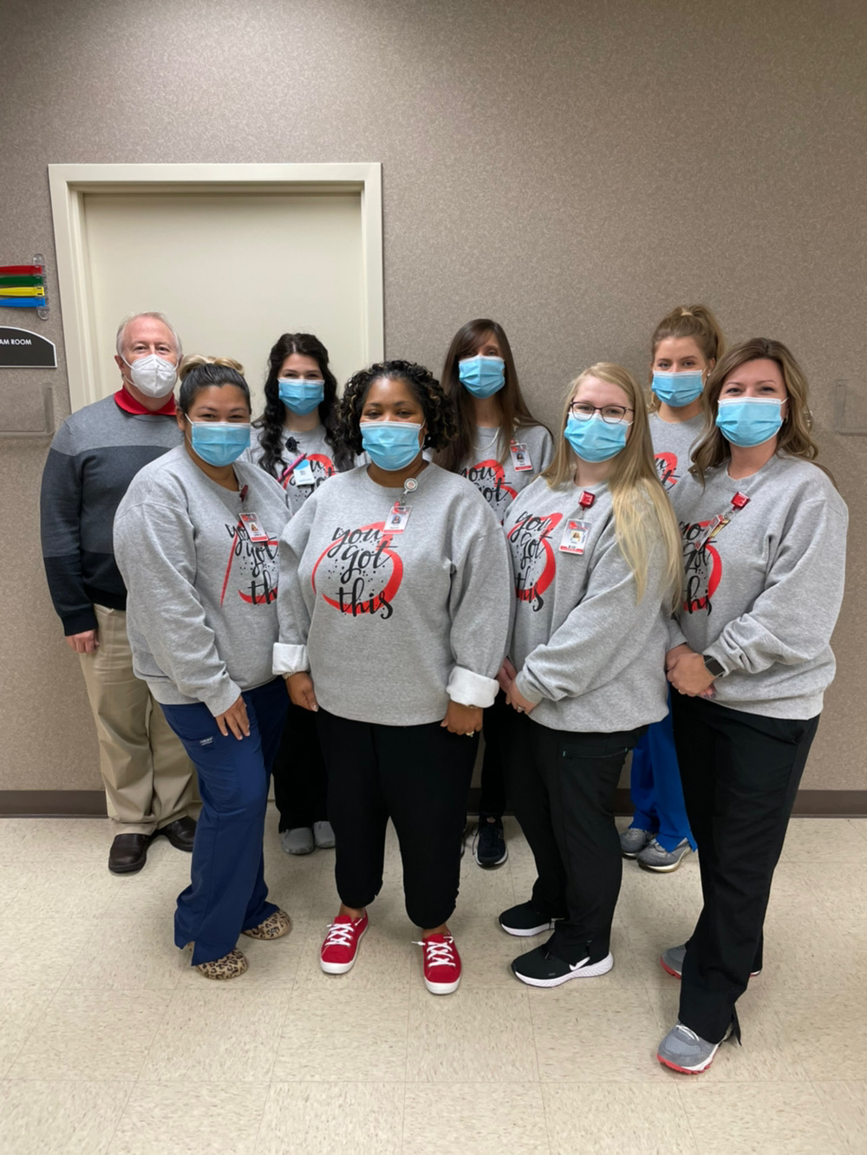
Pregnancy Clinic Services
  Provides comprehensive prenatal care to every patient regardless of their ability to pay
  Currently caring for an average of 57 new OB patients each month
  3 OBGYN physicians, 2 Advanced Practice Nurses, nurses, social worker, full service ultrasound, lab services, houses the ANGELS telemed high risk ultrasound, outpatient lactation services, maternal substance abuse program, maternal mental health services with SBCC
Notes:
50-70 new patients per month– accounts for 40% of deliveries at the hospital
2022 4,398 visits
2023 TD 6,195
2 APPs

Slide 10
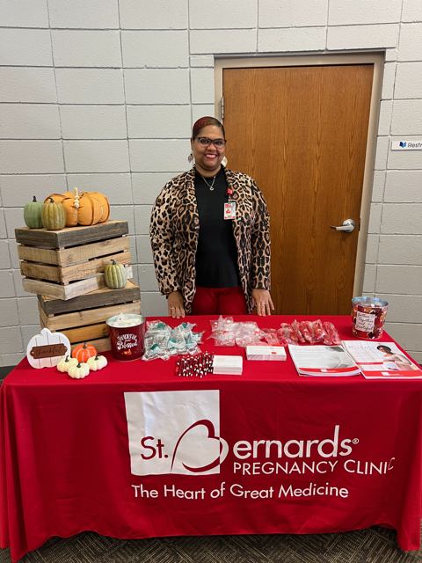
Pregnancy Clinic and SDOH
Assesses each patient for social determinants of health (SDOH) along with their physical, mental, and emotional health status to determine their needs
Providing education, support, resources, group classes, and needed supplies

Slide 11
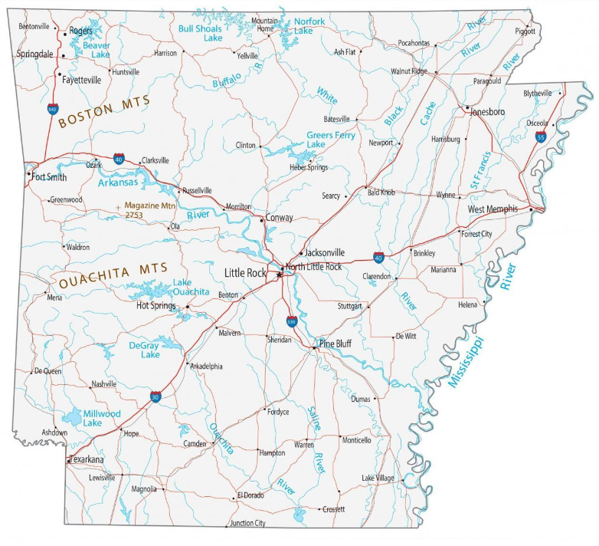
Expansion of St. Bernards Pregnancy Clinic Locations
Osceola
Newport
Marion
Paragould

Slide 12
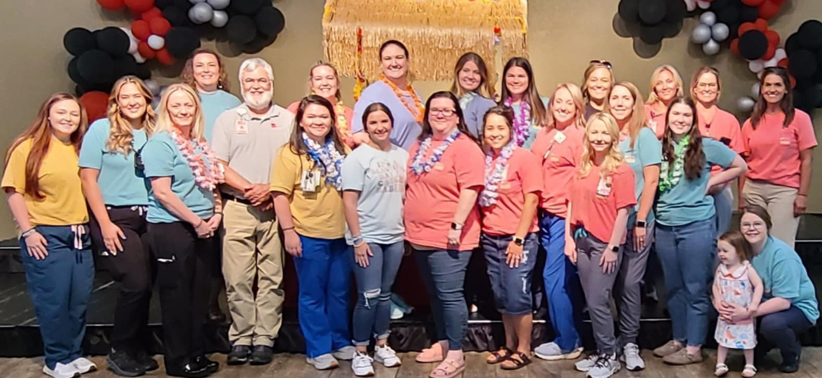
Community Education
Baby State
Prenatal classes
Infant CPR to families
Breastfeeding classes
Back to sleep safety
Carseat safety
Post partum depression
Post birth warning signs
Newborn infection prevention
Educating outlying facilities

Slide 13
Why Maternal Life 360?
High risk patients
Social determinants of health
Lack of post partum care
Notes:
Increased number of high risk patients discovered during clinic visits and additional at risk patients sent to St. Bernards due to our Level 3A NICU. These risks are identified through physical signs and symptoms, but through an in depth social determinant of health screening.
We see patients at our clinic who have food insecurities, unstable housing, lack of transportation, financial constraints, education level,
The state identified the majority of our maternal deaths occur during the first year following delivery. This is related to mental health concerns. Without consistent follow up appointments, we are not able to follow this appropriately.

Slide 14
Parents as Teachers
Arkansas Home Visiting Network
  Parent educators provide the information, support, and encouragement parents need in their role as their child’s first and most influential teacher
Specially trained teachers
In-home visits
Group meetings
Assistance with providing resources for the needs identified in the SDOH screening
Notes:
Based off the grant requirements, we felt that PAT’s were most in line with our mission. Received blue ribbon affiliate accredidation. We will start with 4 teachers that will be making home visits, conducting group sessions, and working closely with our Clinic. Currently seeing clients in Craighead County.

Slide 15
Further Consideration
ARHOME
Craighead County

Slide 16
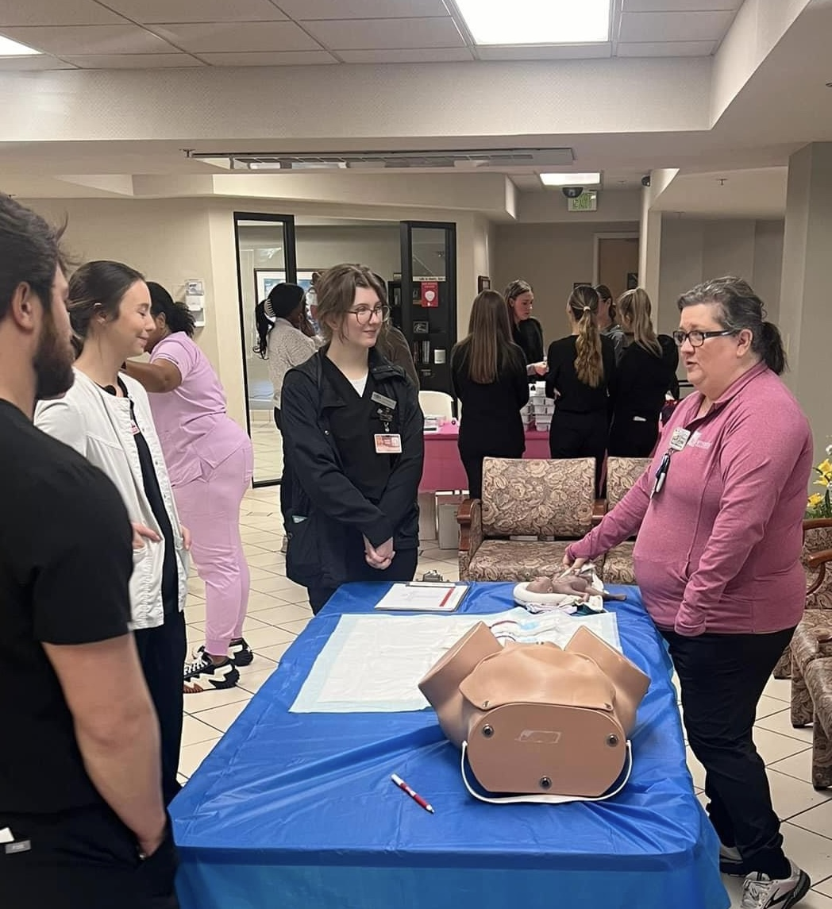
Maternal Safety
Meeting quality/safety measures for post partum hemorrhage, maternal hypertension, maternal sepsis, delivery emergencies such as cord prolapse & shoulder dystocia
Among the lowest primary C-section rates in our region
Notes:
I can list everything we do in the NICU, but the most important item to mention is that we kept 291 babies family’s close to their home this past year. With this capacity, we expanded to 19 beds, with much appreciation to the Luke Kellum’s Foundation.
We have partnered with Medic One to be able to transport patients to our facility from regional facilities or back from Childrens or Lebhoneur. We have performed 37 of these transfers.

Slide 17
Notes:
We have a formal relationship with 8 hospitals in our region, in addition to an Inpatient REHAB and LTACH

