Slide 1
How to submit a PT 21 T1,T2, T6, TO, TP, and TS Therapy application?

Slide 2
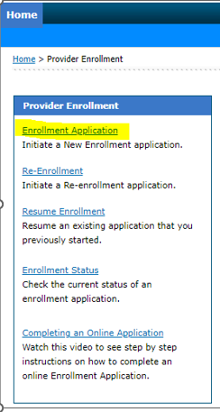
Starting the application
Click the link to - Start your application
Select “Enrollment Application”
Select the options below
Enrollment Type: Individual or Individual within a group
Provider Type: 21
Specialty: T1,T2, T6, TO, TP, and TS
NPI: Enter the National Provider Number of Provider
TAX ID: Add the SSN of the enrolling Provider.

Slide 3
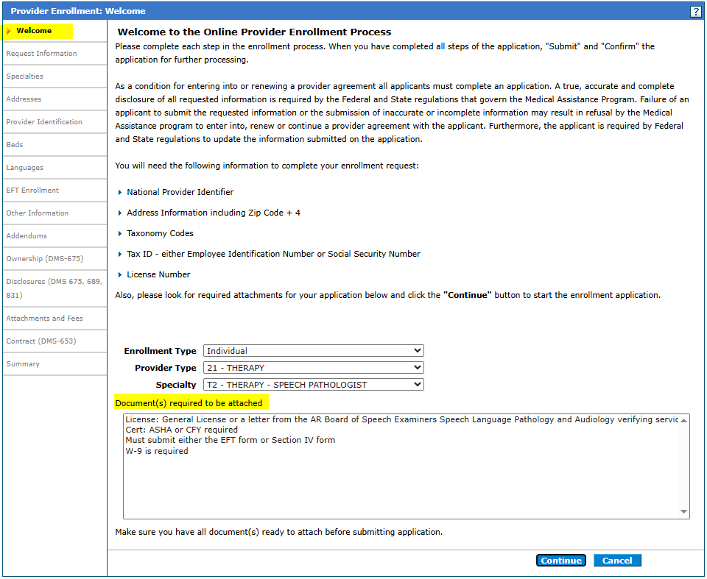
Entering the application data: Welcome tab
The welcome tab details key information that will be asked during the application process. At the bottom, the online application shows if any documentation needs to be attached towards the end of the application. Documents required to be uploaded are License (if applicable), Cert (if applicable), EFT form with Voided check or Bank Letter, and W-9.
Applying as individual within a group can replace the EFT requirement with a Section IV affiliation form to link with an established group.
Submitting through the portal it is recommended not to add any additional paper documents unless additional information is requested or
Hit continue to proceed with the application.

Slide 4
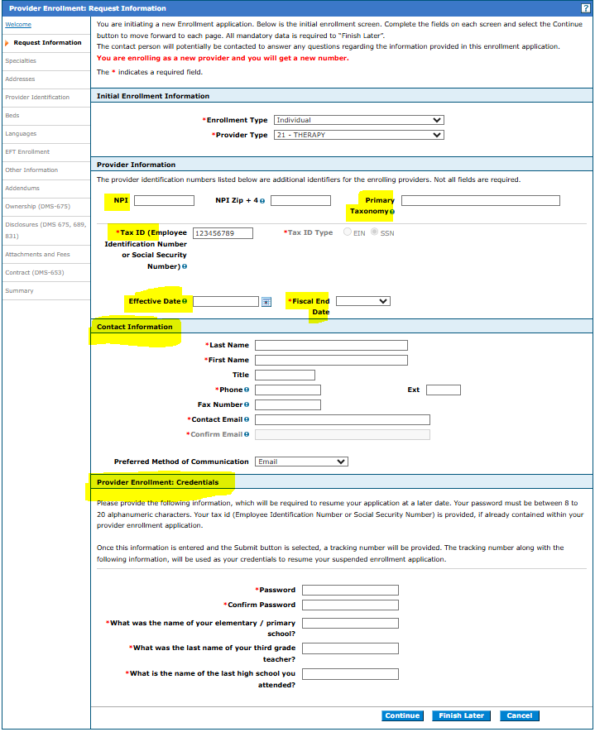
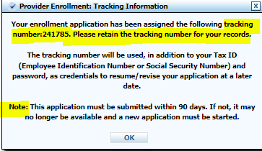
Entering the application data: Requested Information
NPI & Primary Taxonomy: Required.
TAX ID: List the SSN of the enrolling provider.
Primary Taxonomy – Search for appropriate taxonomy code
Effective date – List a requested effective date or place today’s date.
Fiscal Year End: Enter December unless the fiscal year ends on another date.
Complete Contact Information: This section will receive email notifications if the ATN is RTP’d. RTP = Returned to Provider for review/corrections. The contact information listed here is only for the application record.
Provider Enrollment Credentials: Note the password and security questions you completed for your application. If you need to check the status online or re-access the application after RTP to resubmit for processing, this information will be asked and can't be reset.
Once all sections have been completed, hit continue and a message will pop up with your application tracking ID. An email notification will also be sent.

Slide 5
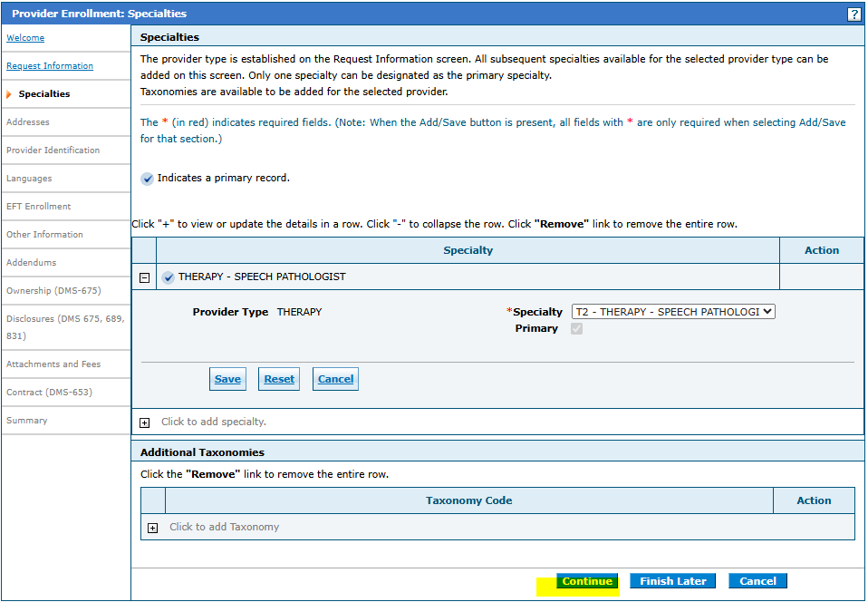
Entering the application data: Specialties tab
Add specialty and hit continue to proceed with the application.

Slide 6
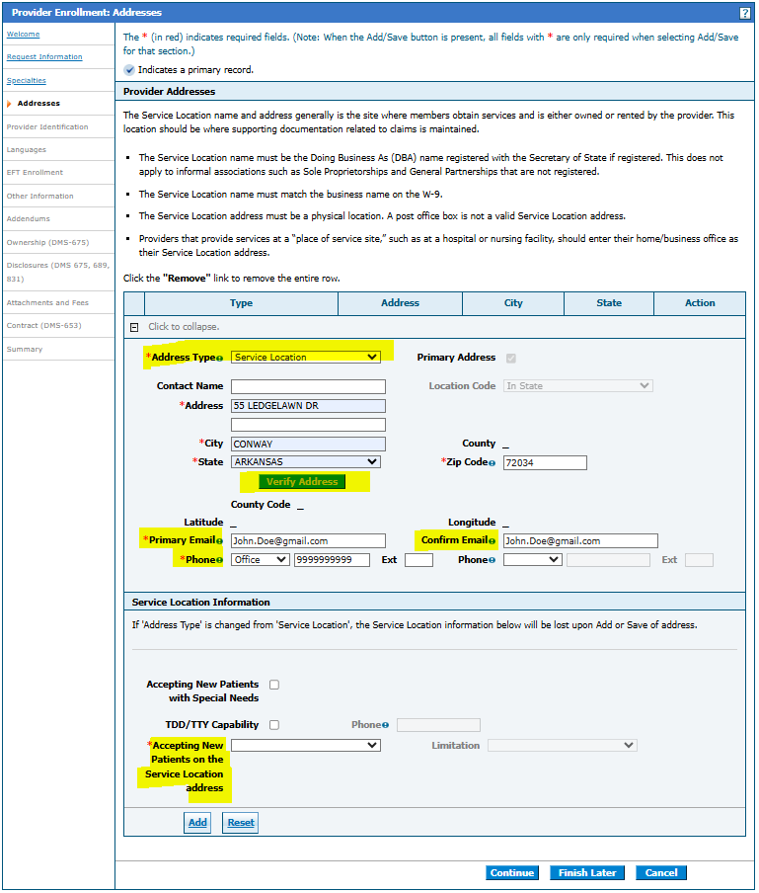
Entering the application data: Addresses
Service location is required. Once entered, you must hit “Verify Address” before the application will allow you to save the information.
Complete address info for the Home Office, Mail to, and Pay to. If these sections are not completed, the information listed on the service location will be copied to all addresses upon enrollment.

Slide 7
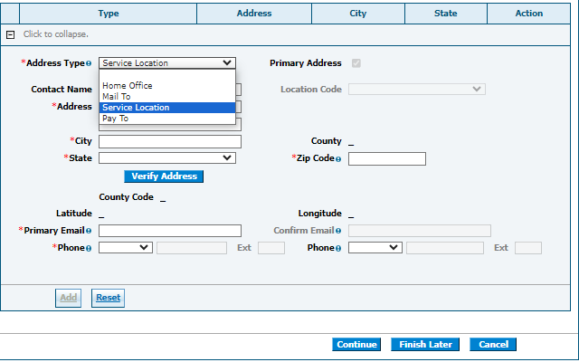
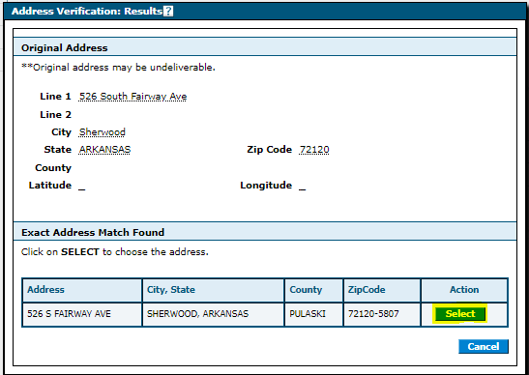
Entering the application data: Addresses

Slide 8
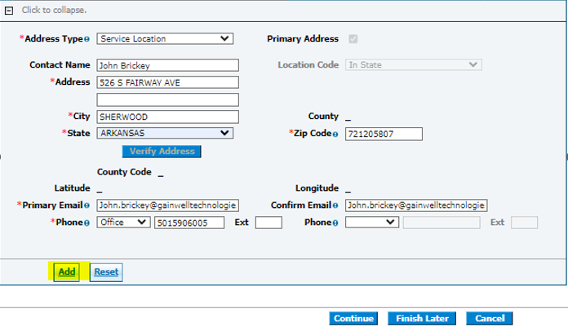
Entering the application data: Requested Information

Slide 9
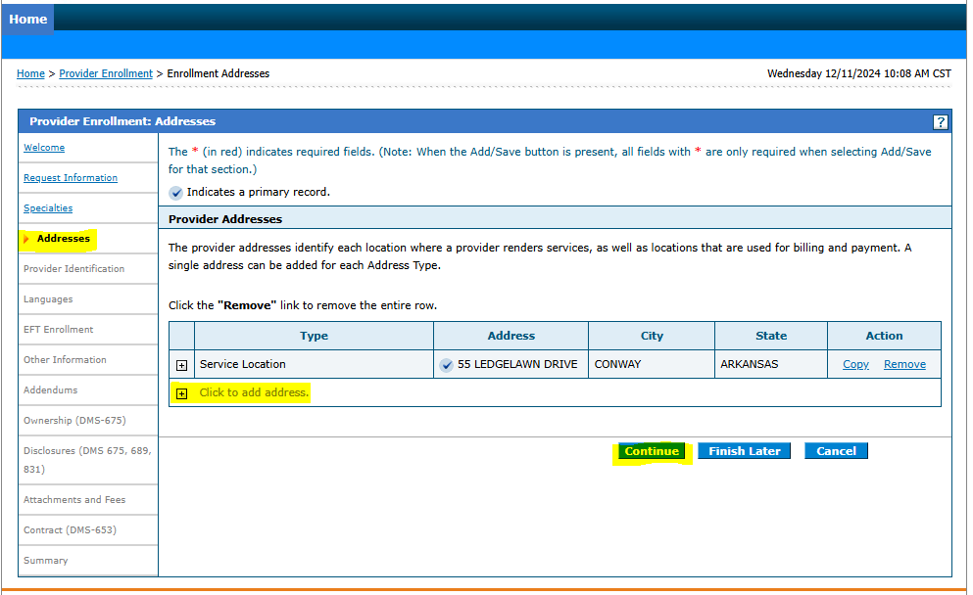
Entering the application data: Requested Information

Slide 10
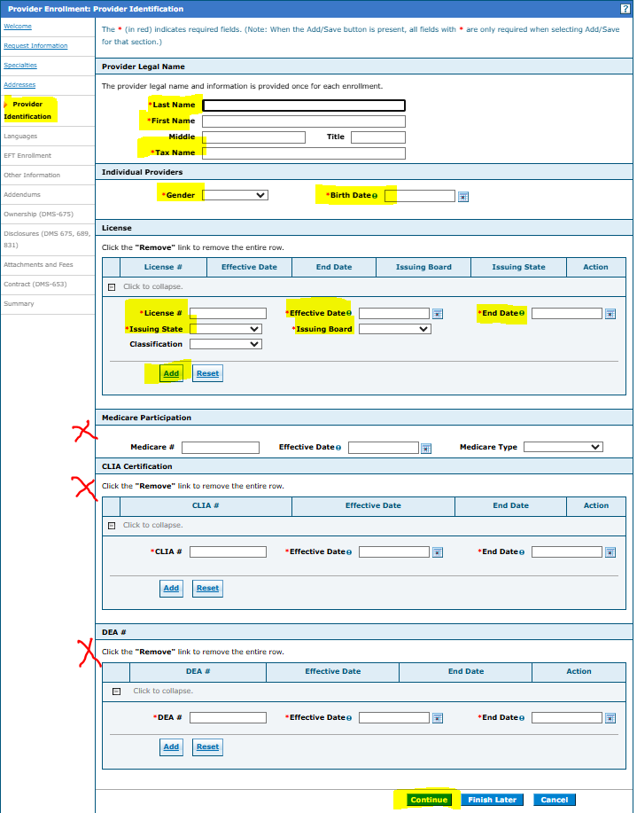
Entering the application data: Provider Identification
Provider Legal Name: List the Individual Therapy provider legal name.
Tax Name: This section should match the same individual name.
Gender/DOB: Enter the gender & DOB of the Therapy provider.
License: Enter Therapy provider License
CLIA: Optional
Medicare and DEA – These sections do not apply to enrolling Therapy providers. Should be left blank, and the application will allow you to continue through submission.

Slide 11
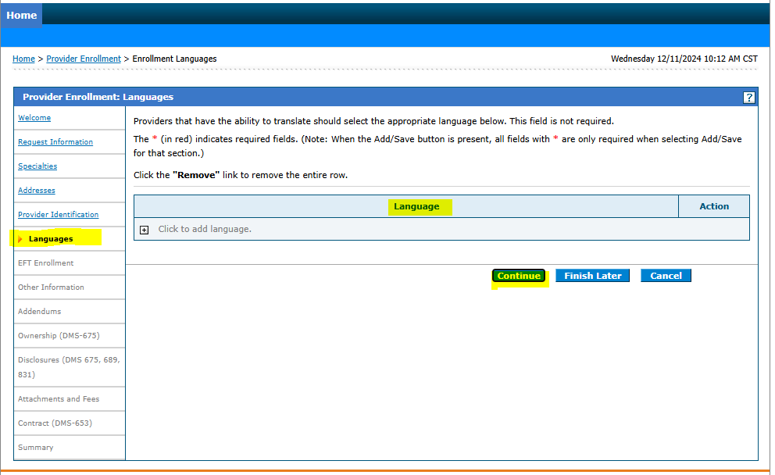
Entering the application data: Languages
Language is optional – You can list any language or continue to proceed with the application.

Slide 12
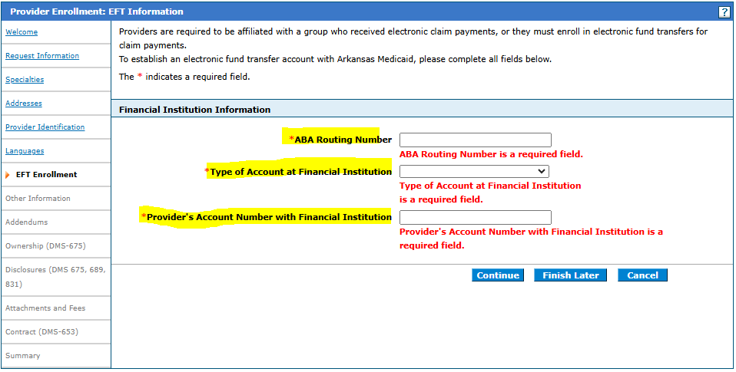
Entering the application data: EFT Enrollment
ABA Routing Number: Enter routing number to financial institution
Type of Account: Select type of account
Provider Account Number: Enter provider’s account number with financial institution
Bank letter or a voided check under the enrolling provider name is required to be uploaded with the EFT Form application. The downloadable EFT Form AND Section IV can be found on DHS website: https://humanservices.arkansas.gov/divisions-shared-services/medical-services/provider-enrollment/

Slide 13
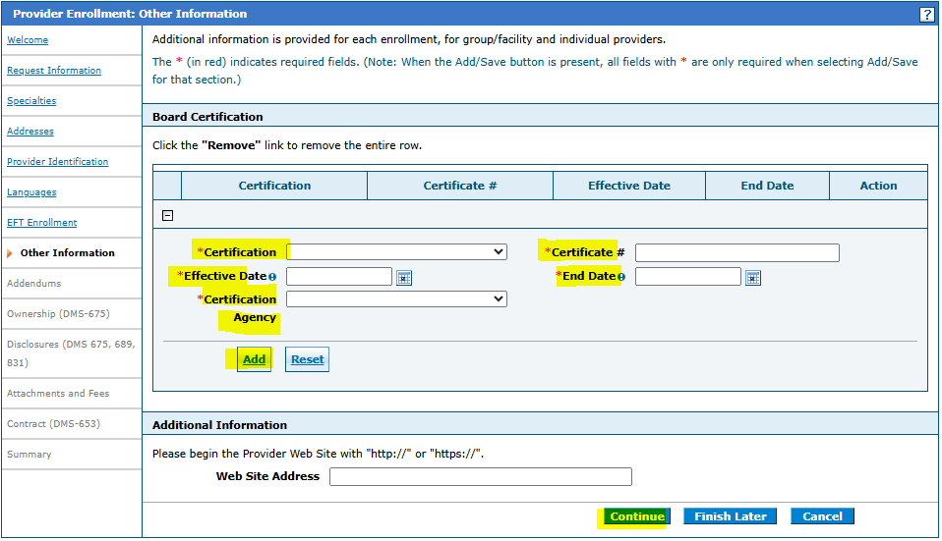
Entering the application data: Other Information
Certification – You can add Certification information
CFY Plan – If the provider is under a CFY plan. Please select “ASHA” as the cert and “CFYPLAN” as certification number. A SLP Clinical Fellowship Year Plan will be required to be uploaded.

Slide 14
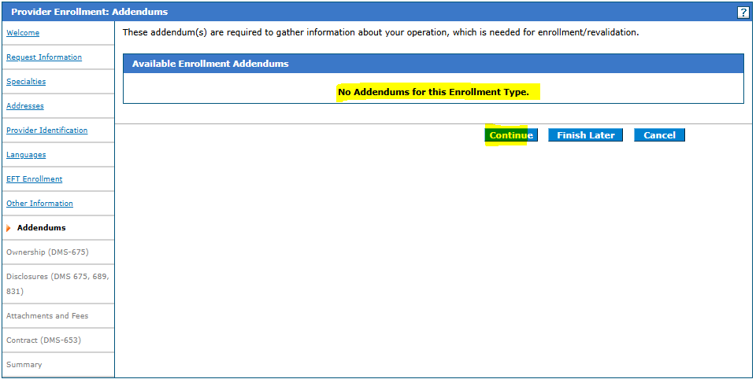
Entering the application data: Addendums
There are no Addendums for this enrollment type. Hit continue to proceed with the application.

Slide 15
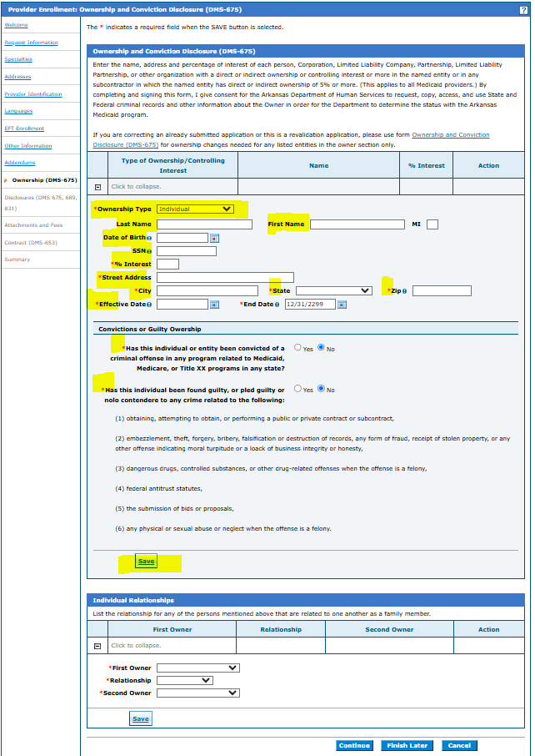
Entering the application data: Ownership (DMS-675)
Add the individual provider’s information
Individual relationship is not required.

Slide 16
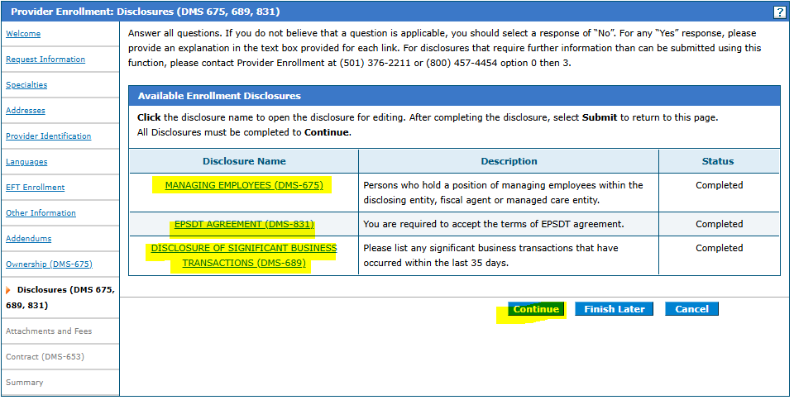
Entering the application data: Disclosures (DMS 675, 689, 831)
Complete all the disclosure agreements.
Click on each disclosure name to answer and save information.

Slide 17
Specialty Site Visit Requirement – Therapy License Type & Certification
Site visit: T1 and TP require site visits
License Type: Upload professional license type associated with specialty
ASHA Certificate or CFY Plan: Required for Provider Type T2
Supervisory Letter: Required for Provider Type TS
Letter must list the enrolling provider and supervising provider.
Letter must list start and end date of supervision for the enrolling provider.
Letter effective and end date of supervision must match the effective and end date of the license.
Letter can be issued from the supervisor or Arkansas Dept of Health.
NBCOT Certificate: Required for Provider Type T6
Specialty |  | Site Visit Required | License Type | ASHA / CFY Plan | Supervisory Letter | NBCOT
T2 | Speech Language Pathologist | N/A | Speech Language Pathologist, Type SP, or Provisional | Required | N/A | N/A
TS | Therapy - Speech Pathologist Assistant | N/A | Speech Language Pathology Assistant or Asst. | N/A | Required | N/A
T6 | Therapy - Occupational | N/A | Occupational Therapist or list OTR | N/A | N/A | Required
TO | Therapy - Occupational Assistant | N/A | Occupational Therapist Assistant or list OT-A | N/A | N/A | N/A
T1 | Therapy - Physical | (Site Visit Required) | Physical Therapy or PT | N/A | N/A | N/A
TP | Therapy - Physical Assistant | (Site Visit Required) | Physical Therapy Assistant or PTA | N/A | N/A | N/A

Slide 18
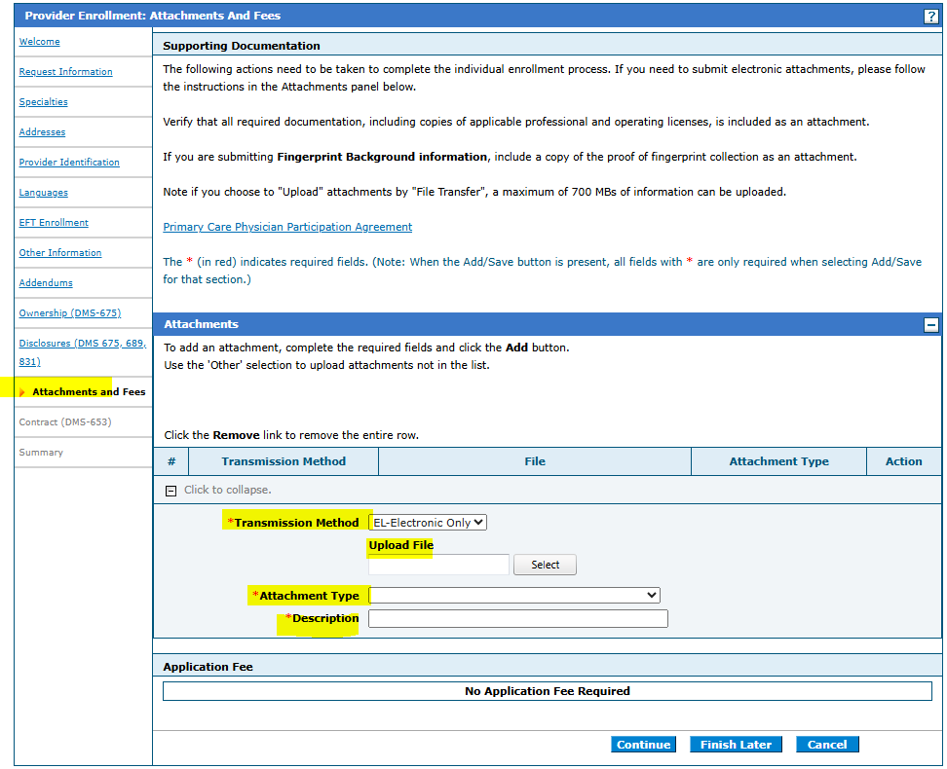
Entering the application data: Attachments and Fees
The application requires the EFT Form with bank letter or voided check, License, Certification, and W-9 to be attached.
Section IV form if Enrolling as individual within a group
Professional License
W-9 required be in the individual provider’s information.
It is recommended not to attach any additional documents to the initial submission unless additional information is being requested.
Paper forms should not be uploaded when submitting applications electronically through the portal website.
All optional listings are only needed if applicable or requested.

Slide 19
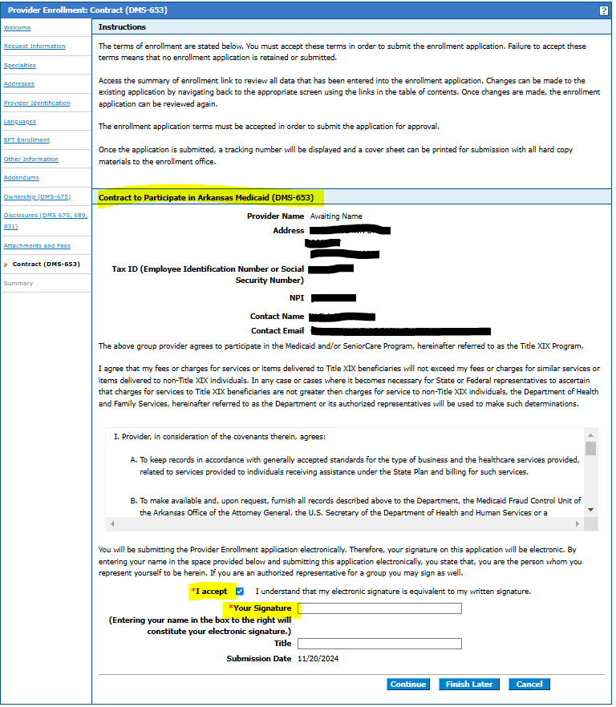
Entering the application data: Contract (DMS-653)
Click “I Accept” to terms of agreement
Enter the providers legal name and title to finalize the signature page for the application.

Slide 20
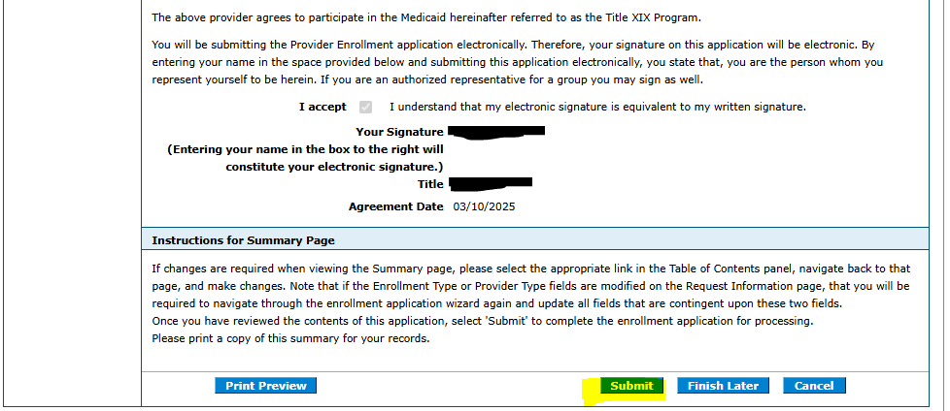
Entering the application data: Summary
This is a preview of your application before you complete your submission.
Must go to the bottom of the page to complete the submission of the application.
Hit “Print Preview” to save a copy of the application summary for your records.
Hit “Submit” to complete the application. Save the tracking ID for your records.

Slide 21
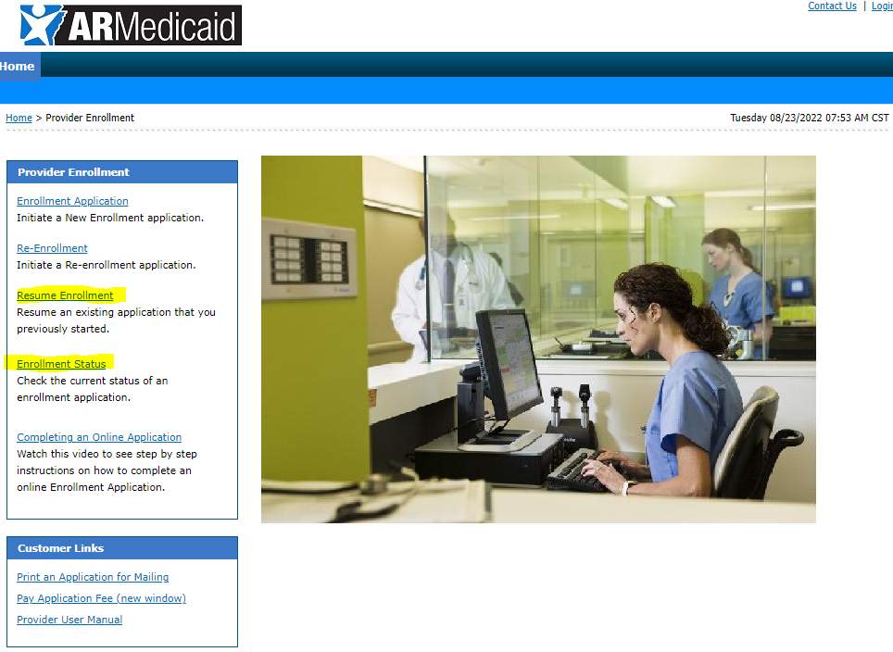
Applications submitted on portal
You can check the status of any application submitted and see any notes for corrections or documents needed to complete your application.
If corrections are needed, you can click the “Resume Enrollment” to access the previously submitted application and upload any document or make changes need for your application and resubmit.

