Slide 1
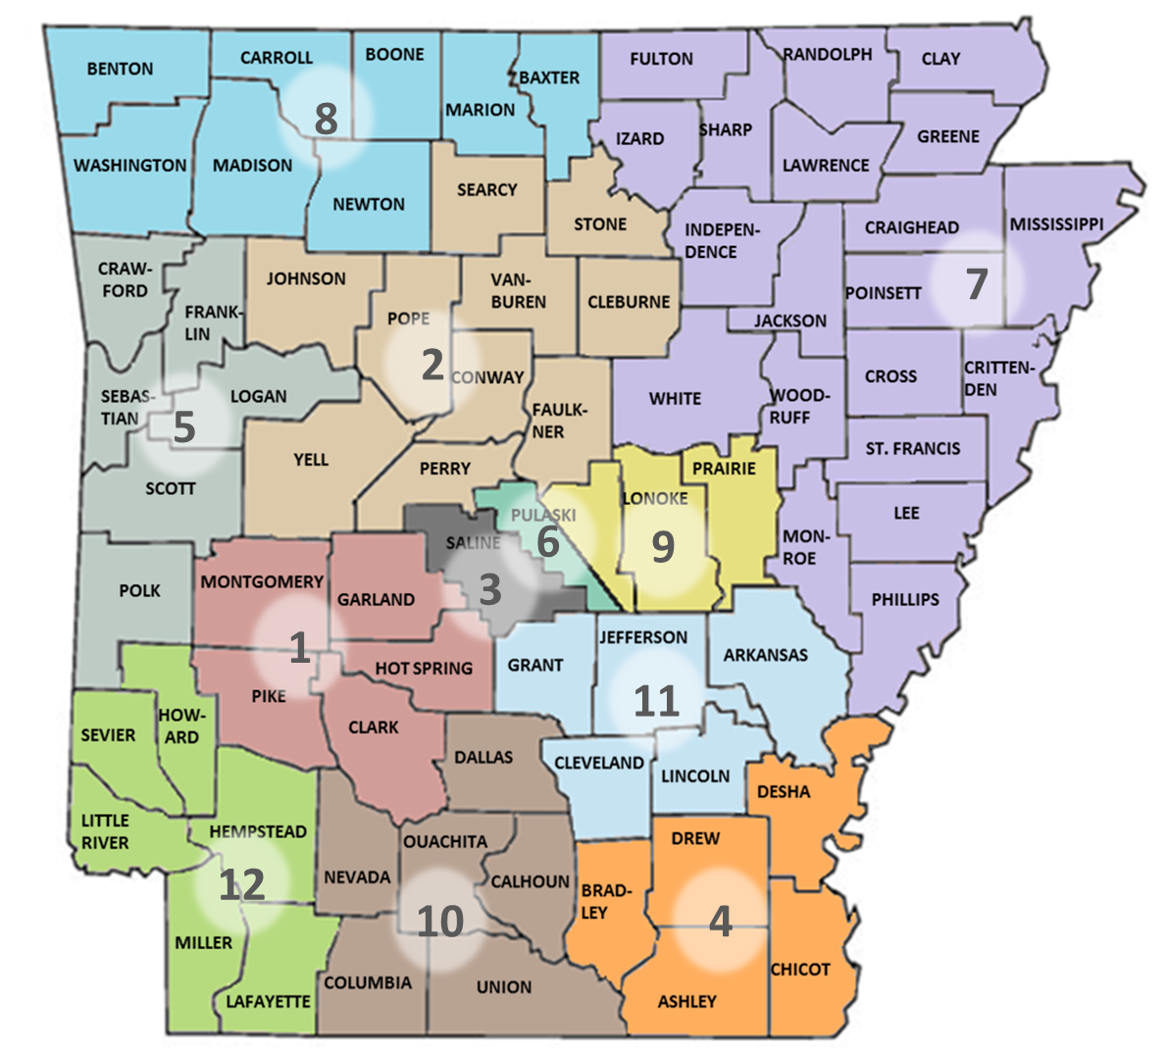
Arkansas Community Mental
Health Center Directory
Arkansas Department of Human Services
Office of Substance Abuse and Mental Health
Central Administration Office
Physical Address: 700 Main St.
Little Rock, AR 72203
Telephone: 501.686-9164
Fax: 501.404-4614
humanservices.arkansas.gov

Slide 2
Arkansas Community Mental
Health Center Directory
Area | Provider | Telephone
1 | Ouachita Behavioral Health and Wellness | 501-624-7111 or 800-264-2410
2 | Counseling Associates, Inc. | 501-336-8300 or 800-844-2066
3 | Counseling Clinic, Inc. | 501-315-4224 or 877-926-3820
4 | Delta Counseling Associates | 870-367-2461
5 | Western Arkansas Counseling & Guidance Center | 479-452-6650 or 800-542-1031
6 | Centers for Youth and Families | 501-664-4308 or 888-868-0023
7 | Arisa Health (formerly Mid-South Health Systems, Inc.) | 870-972-4000 or 877-201-0510
8 | Ozark Guidance Center, Inc. | 479-750-2020 or 800-234-7052
9 | Professional Counseling Associates | 501-221-1843
10 | Newhaven Counseling & Health (formerly South Arkansas Regional Health Center) | 870-862-7921 or 800-825-1554
11 | Southeast Arkansas Behavioral Healthcare System, Inc. | 870-534-1834 or 800-272-2008
12 | Southwest Arkansas Counseling & Mental Health Center, Inc. | 870-773-4655 or 800-652-9166
1

Slide 3
Arkansas Community Mental
Health Center Directory
Area 1
Ouachita Behavioral Health and Wellness
Contact Information: 125 Wellness Way Hot springs, AR 71913 501-624-7111 or 800-264-2410 www.obhaw.org Non-emergency Warm Line: 501-385-1588 24/7 Emergency Services Number: 800-264-2410 | Counties Served: Clark Garland Hot Spring Montgomery Pike
Area 2
Counseling Associates, Inc.
Contact Information: 350 Salem Road, Suite 9 Conway, AR 72034 501-336-8300 or 800-844-2066 www.caiinc.org Non-emergency Warm Line: 833-236-2131 24/7/ Emergency Services Number: 800-356-3035 | Counties Served: Cleburne Conway Faulkner Johnson Perry Pope Searcy Stone Van Buren Yell
Area 3
Counseling Clinic, Inc.
Contact Information: 110 Pearson Street Benton, AR 72015 501-315-4224 or 877-926-3820 www.counselingclinicinc.org 24/7 Emergency Services Number: 501-315-2415 | Counties Served: Saline
2

Slide 4
Arkansas Community Mental
Health Center Directory
Area 4
Delta Counseling Associates
Contact Information: 790 Roberts Drive PO Box 820 Monticello, AR 71657 870-367-2461 www.deltacounseling.org 24/7 Emergency Services Number: 800-323-2703 | Counties Served: Ashley Bradley Chicot Desha Drew
Area 5
Western Arkansas Counseling and Guidance Center
Contact Information: 3111 South 70th Street Fort Smith, AR 72903 479-452-6650 or 800-542-1031 www.wacgc.org Non-emergency Warm Line: 479-452-6655 24/7 Emergency Services Number: 800-542-1031 Crisis Stabilization Unit: 479-785-9480 | Counties Served: Crawford Franklin Logan Polk Sebastian Scott
Area 6
Centers for Youth and Families
Contact Information: 1521 Merrill Drive D220 Little Rock, AR 72211 501-664-4308 or 888-868-0023 www.thecentersar.com 24/7 Emergency Services Number: 501-664-4308 | Counties Served: Pulaski (South of the Arkansas River)

Slide 5
Arkansas Community Mental
Health Center Directory
Area 7
Arisa Health (formerly Mid-South Health Systems, Inc.)
Contact Information: 2707 Browns Lane Jonesboro, AR 72401 870-972-4000 or 877-201-0510 www.arisa.health.org 24/7 Emergency Services Number: 800-356-3035 | Counties Served: Clay Craighead Crittenden Cross Fulton Greene Independence Izard Jackson Lawrence | Lee Mississippi Monroe Phillips Poinsett Randolph Sharp St. Francis White
Area 8
Ozark Guidance Center
Contact Information: 2400 South 48th Street Springdale, AR 72762 479-750-2020 or 800-234-7052 www.ozarkguidance.org Warm Line: 833-236-2131 24/7 Emergency Services Number: 800-234-7052 | Counties Served: Baxter Benton Boone Carroll Madison Marion Newton Washington
Area 9
Professional Counseling Associates
Contact Information: 3601 Richards Road North Little Rock Little Rock, AR 72117 501-221-1843 www.pca-ar.org Warm Line: 833-236-2131 Emergency Services Number: 800-356-3035 | Counties Served: Lonoke Prairie Pulaski (North of the Arkansas River)
3

Slide 6
Arkansas Community Mental
Health Center Directory
Area 10
Newhaven Counseling and Health (formerly South Arkansas Regional Health Center)
Contact Information: 715 North College El Dorado, AR 71730 870-862-7921 or 800-825-1554 www.newhavenchs.org 24/7 Emergency Services Number: 800-825-1554 | Counties Served: Calhoun Columbia Dallas Ouachita Nevada Union
Area 11
Southeast Arkansas Behavioral Healthcare System, Inc.
Contact Information: 2500 Rike Drive Pine Bluff, AR 71613 870-534-1834 or 800-272-2008 www.sabhs.org 24/7 Emergency Services Number: 800-272-2008 | Counties Served: Arkansas Cleveland Grant Jefferson Lincoln
Area 12
Southwest Arkansas Counseling and Mental Health Center, Inc.
Contact Information: 2904 Arkansas Boulevard Texarkana, AR 71854 870-773-4655 or 800-652-9166 www.swacmhc.com 24/7 Emergency Services Number: 800-652-9166 | Counties Served: Hempstead Howard Lafayette Little River Miller Sevier

Slide 7
Arkansas Community Mental
Health Center Directory
NAMI Arkansas
National Alliance on Mental Illness Arkansas 1012 Autumn Rd. Ste. 1 Little Rock, AR 72211 | www.namiarkansas.org 24/7 NAMI Helpline: 800-844-0381
Arkansas Department of Human Services
Office of Substance Abuse and Mental Health
Physical Address: 700 Main St.
Mailing Address: P.O. Box 1437, Slot W241
Little Rock, AR 72203
Telephone: 501.686-9164
Fax: 501.404-4614
humanservices.arkansas.gov
Revised 09/13/2023
5

